Slide 1
A children-friendly phonetic transliteration
& a simplified translation of
REHRAAS SAHIB

Slide 2
har jug jug bhagat u-paa’yaa pai’j rakh’daa aa’yaa raam raa’jey.
hir jugu jugu Bgq aupwieAw
pYj rKdw AwieAw rwm rwjy ]
Throughout history Vaheguru creates loving followers and looks out for them.

Slide 3
harNaa’khash dush’tt har maar’yaa prah’laad taraa’yaa.
hrxwKsu dustu hir mwirAw
pRhlwdu qrwieAw ]
Vaheguru saved Saint Prahlaad from his evil father, Harnakash.

Slide 4
a’hunn-kaaree’aa nind’kaa pitth dey’e, naam dey’o mukh laa’yaa.
AhMkwrIAw inMdkw ipiT dyie
nwmdyau muiK lwieAw ]
Vaheguru showed Himself to Naam Dev Ji & not to the people who put others down.

Slide 5
jan naa’nak ai’saa har sey’viyaa, ann’t le’ey chhaddaa’yaa. (4)(13)(20)
jn nwnk AYsw hir syivAw
AMiq ley CfwieAw ]4]13]20]
In times of difficulty, those who loved & followed Vaheguru were saved at the end. ||4||13||20||

Slide 6
salok, mahallaa peh’laa.
sloku mÚ 1 ]
Verse by the First Guru:

Slide 7
dukh daa’roo, sukh rog bheyaa, jaa sukh, taam na ho’ee.
duKu dwrU suKu rogu BieAw
jw suKu qwim n hoeI ]
Hardships help like medicine & enjoyments cause us pain. A happy soul is not hurt.

Slide 8
too^{n} kar’taa kar’Naa, mai naa’hee, jaa hau karee na ho’ee. (1)
qUM krqw krxw mY nwhI
jw hau krI n hoeI ]1]
Vaheguru, You’re Power makes everything happen. I can't do anything on my own. ||1||

Slide 9
bal’haaree, kud’rat vas’yaa. tey’raa ant na jaa’ee lakh’yaa. (1) rahaa’o.
bilhwrI kudriq visAw ]
qyrw AMqu n jweI liKAw ]1] rhwau ]
Vaheguru! I give myself to You, who is in all of nature & so great we can't even imagine.
||1||Pause ||

Slide 10
jaat meh jot, jot meh jaa’taa, a’kall kallaa bhar’poor reh’yaa.
jwiq mih joiq joiq mih jwqw
Akl klw BrpUir rihAw ]
Your Light is in everything & seen in everything. You power is everywhere.

Slide 11
too^{n} sachaa saa’hib sifat suaa’liyoh, jin kee’tee so paar pe’yaa.
qUM scw swihbu isPiq suAwil@au
ijin kIqI so pwir pieAw ]
You are truly in charge! Singing Your beautiful praises helps us get through life.

Slide 12
kahu naa’nak, kar’tey kee’aa baa’taa^{n}, jo kichh kar’Naa, so kar reh’yaa. (2)
khu nwnk krqy kIAw bwqw
jo ikCu krxw su kir rihAw ]2]
Guru Ji says: Speak Vaheguru’s praises who does everything what needs doing. ||2||

Slide 13
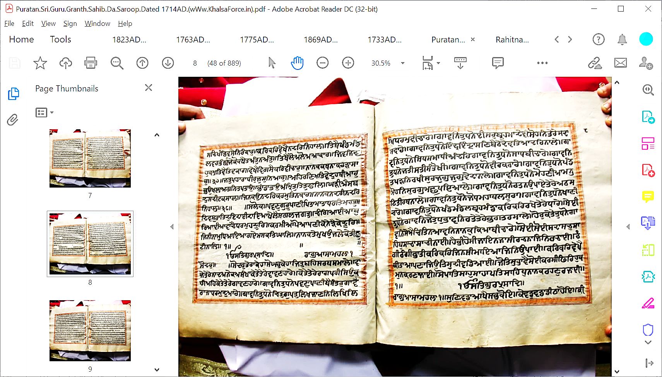
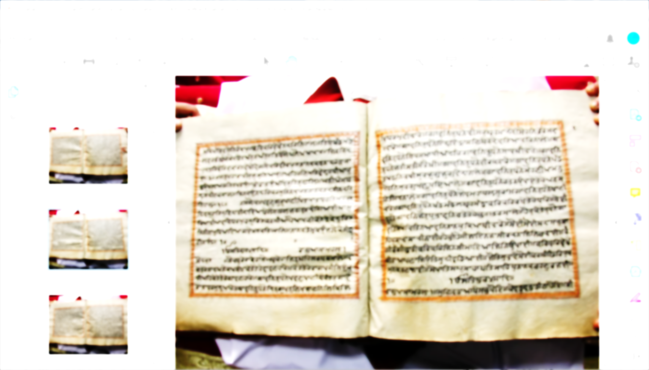
There is One Supreme Power who is the Truth the Giver of Knowledge & Blessings:
‘Aasaa’ (mood of hope) by the First Guru:
So Dar (The Door to Vaheguru)
ikk oh’ann-kaar, sat, gur’prasaad.
raag aasaa, mahallaa peh’laa, so dar.

Slide 14
so dar tey’raa key’haa, so ghar key’haa, jit beh sarab samaaley.
so dru qyrw kyhw so Gru kyhw
ijqu bih srb smwly ]
The world & the special House where you sit & take care everyone are so amazing!

Slide 15
vaajey tey’rey naad aney’k asann’khaa, key’tey tey’rey vaavaN’haarey.
vwjy qyry nwd Anyk AsMKw
kyqy qyry vwvxhwry ]
Endless beautiful music comes from You, that is played by so many musicians.

Slide 16
key’tey tey’rey raag paree si’o kehee’eh, key’tey tey’rey gaavaN’haarey.
kyqy qyry rwg prI isau khIAih
kyqy qyry gwvxhwry ]
Countless musicians use countless musical tunes to sing of You.

Slide 17
gaavan tuDh’no pavaN paaNee bai’santar, gaa’vai raajaa Dharam du’aarey.
gwvin quDno pvxu pwxI bYsMqru
gwvY rwjw Drmu duAwry ]
Wind, water, fire, & the special Judge who stands at Your Door, all sing Your tune.

Slide 18
gaavan tuDh’no chit gupat likh jaaNan, likh likh Dharam bee’chaarey.
gwvin quDno icqu gupqu iliK jwxin
iliK iliK Drmu bIcwry ]
The powers that record what we do good & bad for judgment sing Your tune.

Slide 19
gaavan tuDh’no ee’shar brah’maa dey’vee, so’han tey’rey sadaa savaa’rey.
gwvin quDno eIsru bRhmw dyvI
sohin qyry sdw svwry ]
Forces made by You with the roles to destroy, create & others, sing Your tune.

Slide 20
gaavan tuDh’no indar in’draasaN bai’tthey, dev’tiyaa dar naaley.
gwvin quDno ieMdR ieMdRwsix bYTy
dyviqAw dir nwly ]
The forces appointed to work the skies along with other powers sing Your tune.

Slide 21
gaavan tuDh’no siDh samaa’Dhee an’dar, gaavan tuDh’no saaDh bee’chaarey.
gwvin quDno isD smwDI AMdir
gwvin quDno swD bIcwry ]
Miracle-workers sitting in meditation & saints in deep-thinking sing Your tune.

Slide 22
gaavan tuDh’no jatee satee san’tokhee, gaavan tuDh’no veer karaa’rey.
gwvin quDno jqI sqI sMqoKI
gwvin quDno vIr krwry ]
People who are disciplined, givers, satisfied & brave warriors sing Your tune.

Slide 23
gaavan tuDh’no pann’dit paRhan rakhee’sur, jug jug vey’daa naaley.
gwvin quDno pMifq pVin rKIsur
jugu jugu vydw nwly ]
The learned, wise saints & the readers of the Vedas throughout time sing Your tune.

Slide 24
gaavan tuDh’no mohaNee’aa man mohan, surag machh peyaa’ley.
gwvin quDno mohxIAw mnu mohin
surgu mCu pieAwly ]
Lovely sights of up above, the earth & down below that can trick us, sing Your tune.

Slide 25
gaavan tuDh’no ratan u’paa’ey tey’rey, atth’satth tee’rath naaley.
gwvin quDno rqn aupwey qyry
ATsiT qIrQ nwly ]
Your created precious saints along with places blessed by them sing Your tune.

Slide 26
gaavan tuDh’no joDh mahaa’bal sooraa, gaavan tuDh’no khaa’Nee chaarey.
gwvin quDno joD mhwbl sUrw
gwvin quDno KwxI cwry ]
Brave mighty warriors & the four different ways life can be created, sing Your tune.

Slide 27
gaavan tuDh’no khand mandal brah’mandaa, kar kar rakhey tey’rey Dhaarey.
gwvin quDno KMf mMfl bRhmMfw
kir kir rKy qyry Dwry ]
Your created planets, solar systems & galaxies that You manage sing Your tune.

Slide 28
seyee tuDh’no gaavan, jo tuDh bhaavan, ratey tey’rey bhagat rasaaley.
syeI quDno gwvin jo quDu Bwvin
rqy qyry Bgq rswly ]
Those who are pleased with, sing Your tune & are filled with Your love.

Slide 29
hor key’tey tuDh’no gaavan, sey mai chit na aavan, naa’nak kiyaa bee’chaarey.
hoir kyqy quDno gwvin sy mY iciq n Awvin nwnku ikAw bIcwry ]
So many others we are not aware of sing Your tune. How can I think about them all?

Slide 30
so’ee so’ee, sadaa sach saa’hib, saa’chaa, saa’chee naa’ee.
soeI soeI sdw scu swihbu
swcw swcI nweI ]
You are forever truly in control & Your true praises exist forever.

Slide 31
hai bhee ho’see, jaa’e na jaa’see, rach’naa jin rachaa’ee.
hY BI hosI jwie n jwsI
rcnw ijin rcweI ]
You are the Creator of the creation who exists now & always; never leaving us.

Slide 32
rann’gee rann’gee bhaa^{N}’tee, kar kar jin'see, maa’yaa jin u’paa’ee.
rMgI rMgI BwqI kir kir ijnsI
mwieAw ijin aupweI ]
You created the world-play with different kinds of species of different colours.

Slide 33
kar kar dey’khai, kee’taa aa’paNaa, ji’o tis dee vad’yaaee.
kir kir dyKY kIqw Awpxw
ijau iqs dI vifAweI ]
What makes You great is that You watch over the creation that You created.

Slide 34
jo tis bhaa’vai, so’ee kar’see, fir hukam na kar’Naa jaa’ee.
jo iqsu BwvY soeI krsI
iPir hukmu n krxw jweI ]
You do whatever You know is best, and no one can give You orders.

Slide 35
so paat’shaah, shaa’haa pat’saahib, naa’nak rehaN razaa’ee. (1)
so pwiqswhu swhw piqswihbu
nwnk rhxu rjweI ]1]
Vaheguru! You are the King of all kings & Guru Nanak Ji lovingly follows You. ||1||

Slide 36
aa’saa, mahallaa peh’laa.
Awsw mhlw 1 ]
Written in Aasaa (mood of hope)
by the First Guru:

Slide 37
suN vaddaa, aa’khai sabh ko’e. key’vad vaddaa, dee’tthaa ho’e.
suix vfw AwKY sBu koie ]
kyvfu vfw fITw hoie ]
Hearing about You, all say You’re amazing! Seeing for yourself one truly understands.

Slide 38
kee’mat paa’e naa keh’yaa jaa’e. keh’Nai vaaley tey’rey rehey samaa’e. (1)
kImiq pwie n kihAw jwie ]
khxY vwly qyry rhy smwie ]1]
No one can fully understand or describe You. Describers gets absorbed in You. ||1||

Slide 39
vaddey mey'rey saahibaa, gehir gam’bheeraa, guNee geheeraa. ko’e na jaa’Nai tey’raa, key’taa kevad cheeraa. (1) rahaa'o.
vfy myry swihbw gihr gMBIrw guxI ghIrw ]
koie n jwxY qyrw kyqw kyvfu cIrw ]1] rhwau]
My Great Master, You are patient & endless in goodness. No one knows how great You are. ||1||Pause||

Slide 40
sabh sur’tee, mil surat kamaa’ee. sabh kee’mat, mil kee’mat paa’ee.
siB surqI imil suriq kmweI ]
sB kImiq imil kImiq pweI ]
If all people who meditate got together & thought of how much Your value is,

Slide 41
giyaanee Dhiyaanee gur gur’haaee. kehaN naa jaa’ee tey’ree til vad’yaaee. (2)
igAwnI iDAwnI gur gurhweI ]
khxu n jweI qyrI iqlu vifAweI ]2]
If wise thinkers & great teachers join. They all cannot speak a tiny bit of how great You are. ||2||

Slide 42
sabh sat, sabh tap, sabh chan’giyaaee’yaa^{N}. siDhaa pur’khaa kee’aa vad’yaaee’yaa^{N}.
siB sq siB qp siB cMigAweIAw ]
isDw purKw kIAw vifAweIAw ]
All acts of charity, devotion, good deeds, & acts of miracle-men impress the world.

Slide 43
tuDh viN siDhee kin’ai na paaee’yaa. karam mil’ai naa’hee tthaak rahaaee’yaa. (3)
quDu ivxu isDI iknY n pweIAw ]
krim imlY nwhI Twik rhweIAw ]3]
But without You, there’s no true success. Getting Your kind help, nothing stops us.|3||

Slide 44
aa’khaN vaa’laa kiyaa vey’chaaraa. sif’tee bharey tey’rey bhann’daaraa.
AwKx vwlw ikAw vycwrw ]
isPqI Bry qyry BMfwrw ]
Knowing so little how can we describe You? You’re a treasure full of good things.

Slide 45
jis too deh, tis’ai kiyaa chaa’raa. naa’nak sach savaaraN’haaraa. (4)(2)
ijsu qU dyih iqsY ikAw cwrw ]
nwnk scu svwrxhwrw ]4]2]
When You give to us, no one else can do anything. You forever make us beautiful. ||4||2||

Slide 46
aa’saa mahallaa peh’laa.
Awsw mhlw 1 ]
Written in Aasaa (emotion of hope)
by the First Guru:

Slide 47
aa’khaa^{N} jee’vaa^{N}, vis’rai mar jaa’o. aa’khaN au’khaa saa’chaa naa’o.
AwKw jIvw ivsrY mir jwau ]
AwKix AauKw swcw nwau ]
Saying Your Name, I feel alive & dead forgetting it. Saying the True Name is hard.

Slide 48
saa’chey naam kee laa’gai bhookh. ut bhoo’khai khaa’e chalee’eh dookh. (1)
swcy nwm kI lwgY BUK ]
auqu BUKY Kwie clIAih dUK ]1]
The hunger of wanting to remember Your Name eats up our feelings of pains. ||1||

Slide 49
so kiyo vis’rai mey’ree maa’e. saa’chaa saa’hib saa’chai naa’e. (1) rahaa’o.
so ikau ivsrY myrI mwie ]
swcw swihbu swcY nwie ]1] rhwau ]
Dear intelligence! How can I forget the True Master whose Name is True. ||1||Pause||

Slide 50
saa’chey naam kee til vad’yaaee. aakh thakkey kee’mat nehee paa’ee.
swcy nwm kI iqlu vifAweI ]
AwiK Qky kImiq nhI pweI ]
To describe just a bit of the greatness of Your Name people have got tired & failed.

Slide 51
jey sabh mil kai aa’khaN paa’eh. vaddaa naa ho’vai, ghaat naa jaa’e. (2)
jy siB imil kY AwKx pwih ]
vfw n hovY Gwit n jwie ]2]
If everyone got together to praise You, You become no greater, & no less, if they don’t. ||2||

Slide 52
naa oh’hu mar’ai naa ho’vai soh’g. den’daa reh’ai na choo’kai bhog.
nw Ehu mrY n hovY sogu ]
dydw rhY n cUkY Bogu ]
You never die nor made sad. You always give to everyone & never run out.

Slide 53
guN ey’ho, hor naa’hee ko’e. naa ko ho’aa, naa ko ho’e. (3)
guxu eyho horu nwhI koie ]
nw ko hoAw nw ko hoie ]3]
Your unique trait is that there’s no one like You. There never has & there never will. ||3||

Slide 54
jey’vad aap, tey’vad tey’ree daat. jin din kar kai kee’tee raat.
jyvfu Awip qyvf qyrI dwiq ]
ijin idnu kir kY kIqI rwiq ]
Just as You are great, Your gifts are great. You made both the day & night.

Slide 55
khasam visaar’eh tey kam’jaat. naa’nak naa’vai baajh sanaat. (4)(3)
Ksmu ivswrih qy kmjwiq ]
nwnk nwvY bwJu snwiq ]4]3]
Lowly are those don’t acknowledge the Master. Without ‘Naam’ one is the lowliest. ||4||3||

Slide 56
raag goo’jaree, mahallaa chau’taa.
rwgu gUjrI mhlw 4 ]
Written in Goojaree (emotion of prayer)
by the Fourth Guru:

Slide 57
har key jan sat’gur sat-pur’khaa, bin’oh karo gur paas.
hir ky jn siqgur siqpurKw
ibnau krau gur pwis ]
O True Guru! The only True Person! Accepted by Vaheguru! I make this request:

Slide 58
ham kee’rey kiram, sat’gur sar’Naaee, kar dayaa naam par’gaas. (1)
hm kIry ikrm siqgur srxweI
kir dieAw nwmu prgwis ]1]
I am like a tiny ant coming to You. Kindly fill me with Your light through Your Sound. ||1||

Slide 59
mey’rey meet gur’dev, mo ko raam naam par’gaas.
myry mIq gurdyv
mo kau rwm nwmu prgwis ]
Guru Ji! My Best Friend! With Your Sound, please fill me with Your special light.

Slide 60
gur’mat naam mey’raa praan sakhaa’ee, har keerat, ham’ree reh’raas. (1) rahaa’o.
gurmiq nwmu myrw pRwn sKweI
hir kIriq hmrI rhrwis ]1] rhwau ]
With Guru Ji’s help, Your Sound becomes my breath & praising You becomes my job. ||1||Pause.||

Slide 61
har jan key, vad bhaag vaderey, jin har har shar’Dhaa, har piyaas.
hir jn ky vf Bwg vfyry
ijn hir hir srDw hir ipAws ]
The followers who have love, respect & want for Vaheguru, are the luckiest of all.

Slide 62
har har naam, mil’ai trip’taas’eh, mil sangat, guN par’gaas. (2)
hir hir nwmu imlY iqRpqwsih
imil sMgiq gux prgwis ]2]
Vaheguru’s Name makes them happy & in the Sangat, their goodness shines. ||2||

Slide 63
jin, har har, har ras, naam naa paa’yaa, tey bhaag’heeN jam paas.
ijn hir hir hir rsu nwmu n pwieAw
qy BwghIx jm pwis ]
Those who find no joy in meditation are not lucky & get caught by Messengers of Death.

Slide 64
jo sat’gur sharaN sangat nehee aa’ey,
Dhrig jee’vey, Dhrig jee’vaas. (3)
jo siqgur srix sMgiq nhI Awey
iDRgu jIvy iDRgu jIvwis ]3]
Not spending time with the Guru or Sangat, one’s life and hopes become meaningless. ||3||

Slide 65
jin har jan sat’gur sangat paa’ee, tin Dhur mas’tak likh’yaa likhaas.
ijn hir jn siqgur sMgiq pweI
iqn Duir msqik iliKAw ilKwis ]
Good fortune is written for those loving followers who keep company of Guru Ji.

Slide 66
Dhan Dhann sat’sangat, jit har ras paa’yaa, mil jan naa’nak naam par’gaas. (4)(4)
Dnu DMnu sqsMgiq ijqu hir rsu pwieAw
imil jn nwnk nwmu prgwis ]4]4]
The Sangat where Your joy is felt is great. There, one lights up with Your Sound. | |4||4||

Slide 67
raag goo’jaree, mahallaa panj’vaa.
rwgu gUjrI mhlw 5 ]
Written in Goojaree (emotion of prayer) by the Fifth Guru:

Slide 68
kaa’hey rey, man chit’veh u’dam, jaa aa’har har jee’o par’yaa.
kwhy ry mn icqvih audmu
jw Awhir hir jIau pirAw ]
O mind, why worry, when Vaheguru will look after you?

Slide 69
sai’l pathar meh jant u-paa’ey, taa kaa rizak, aa’gai kar Dhar’yaa. (1)
sYl pQr mih jMq aupwey
qw kw irjku AwgY kir DirAw ]1]
Vaheguru even makes arrangements & provides food for life living in rocks. ||1||

Slide 70
mey’rey maa’Dho jee, sat’sangat mil’ey, su tar’yaa.
myry mwDau jI
sqsMgiq imly su qirAw ]
O Master of this world! Joining the True Sangat one is saved.

Slide 71
gur par’saad, param pad paa’yaa sookey kaas’tt har’yaa. (1) rahaa’o.
gur prswid prm pdu pwieAw
sUky kwst hirAw ]1] rhwau ]
Like dry wood turns green again, you can achieve the highest with Guru Ji’s help. ||1|| Pause||

Slide 72
janan, pitaa, loh’k, sut ba’nitaa, ko’e naa kis kee Dhar’yaa.
jnin ipqw lok suq binqw
koie n iks kI DirAw ]
Our mum, dad, friends, children, & life partner – none can truly help us.

Slide 73
sir sir rizak samm’baahey tthaakur, kaa'hey man bhau kar'yaa. (2)
isir isir irjku sMbwhy Twkuru
kwhy mn Bau kirAw ]2]
O mind! But why be scared, when Vaheguru helps & cares everyone. ||2||

Slide 74
oo’dey ood aa'vai sai ko’saa, tis paa’chhai bach’rey chhar’yaa.
aUfy aUif AwvY sY kosw
iqsu pwCY bcry CirAw ]
A bird leaves behinds it’s chicks to fly hundreds of miles & then fly back.

Slide 75
tin kavaN khalaa’vai, kavaN chu'gaavai, man meh simran kar'yaa. (3)
iqn kvxu KlwvY kvxu cugwvY
mn mih ismrnu kirAw ]3]
Ever thought who feeds & guides them? (It’s Vaheguru helping them!). ||3||

Slide 76
sabh niDhaan, das astt siDhaan,
Thaakur kar tal Dhar'yaa.
siB inDwn ds Ast isDwn
Twkur kr ql DirAw ]
Vaheguru! All treasures & special powers are in Your hands.

Slide 77
jan naa’nak, bal bal, sad bal jaaee’yai, tey’raa ant naa paaraa’variyaa. (4)(5)
jn nwnk bil bil sd bil jweIAY
qyrw AMqu n pwrwvirAw ]4]5]
Guru Ji says: Vaheguru! May we always be devoted to You, who has no end. ||4||5||

Slide 78
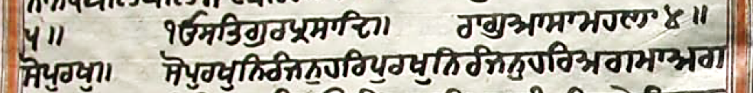
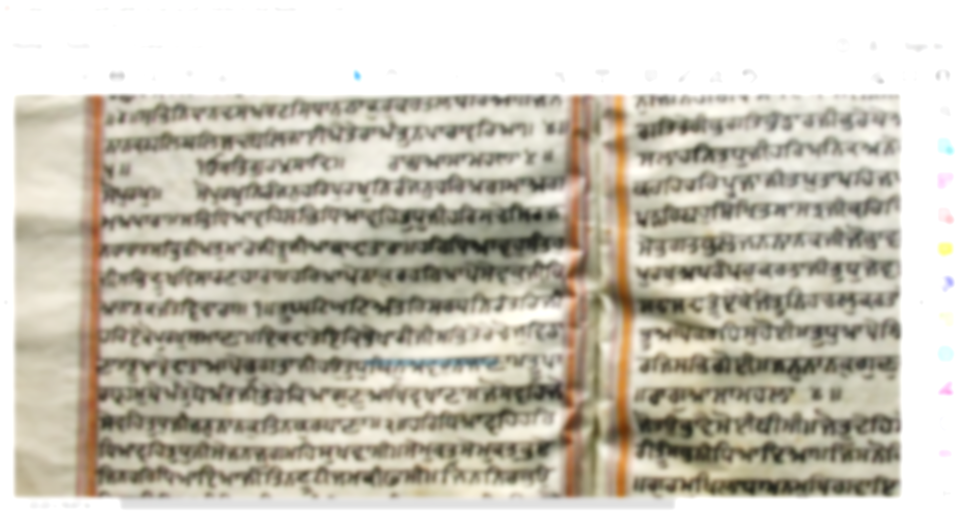
There’s One Ultimate Power who is the Truth & the Giver of Wisdom & Blessings:
Written in Aasaa (mood of hope),
by the Fourth Guru:
‘So Purakh’ – That Supreme Power
ikk oh’ann-kaar, sat, gur’prasaad.
raag aasaa, mahallaa chau’taa, so purakh.

Slide 79
so purakh nirann'jan, har purakh nirann'jan, har a’gammaa a’gamm a’paaraa.
so purKu inrMjnu hir purKu inrMjnu
hir Agmw Agm Apwrw ]
Although Vaheguru is present in all, they are pure, behind thinking & endless.

Slide 80
sabh Dhiyaa'veh, sabh Dhiyaa'veh tuDh jee, har sachey sirjaN'haaraa.
siB iDAwvih siB iDAwvih quDu jI
hir scy isrjxhwrw ]
You are True Creator who everyone thinks of & meditates on.

Slide 81
sabh jeeª tu'maarey jee, too^{n} jee'aa kaa daa'taaraa.
siB jIA qumwry jI
qUM jIAw kw dwqwrw ]
All living beings are created by You & You provide for all them.

Slide 82
har Dhiyaa'vahu sant'hu jee, sabh dookh visaaraN'haaraa.
hir iDAwvhu sMqhu jI
siB dUK ivswrxhwrw ]
O saints! Remember Vaheguru who gets rid of all sufferings.

Slide 83
har aa’pey tthaa’kur, har aa’pey sey’vak jee, k’yaa naa’nak jant ve’chaaraa. (1)
hir Awpy Twkuru hir Awpy syvku jI
ikAw nwnk jMq ivcwrw ]1]
Vaheguru is both Master & servant within all. What can we do without Vaheguru! ||1||
Notes:
ਉਹ (ਸਭ ਜੀਵਾਂ ਵਿਚ ਵਿਆਪਕ ਹੋਣ ਕਰਕੇ) ਆਪ ਹੀ ਮਾਲਕ ਹੈ ਅਤੇ ਆਪ ਹੀ ਸੇਵਕ ਹੈ। ਹੇ ਨਾਨਕ! ਉਸ ਤੋਂ ਬਿਨਾ) ਜੀਵ ਵਿਚਾਰੇ ਕੀਹ ਹਨ? (ਉਸ ਹਰੀ ਤੋਂ ਵੱਖਰੀ ਜੀਵਾਂ ਦੀ ਕੋਈ ਹਸਤੀ ਨਹੀਂ) ॥੧॥

Slide 84
too^{n} ghatt ghatt ann'tar, sarab nirann'tar jee, har ey'ko pu'rakh samaa'Naa.
qUM Gt Gt AMqir srb inrMqir jI
hir eyko purKu smwxw ]
You alone are within all, flowing within every person & thing.

Slide 85
ikk daa'tey, ek bhey'khaaree jee, sabh tey'rey choj ve’daaNaa.
ieik dwqy ieik ByKwrI jI
siB qyry coj ivfwxw ]
But it is Your wondrous play that some people are givers and others are beggars.

Slide 86
too^{n} aa'pey daa'taa, aa'pey bhug'taa jee, hou tuDh bin, avar naa jaa'Naa.
qUM Awpy dwqw Awpy Bugqw jI
hau quDu ibnu Avru n jwxw ]
Really, You are the one who gives & then You enjoy. I don’t anyone else like You!

Slide 87
too^{n} paar'brahm bey'ant bey'ant jee, tey'rey k’yaa guN aakh vakhaa'Naa.
qUM pwrbRhmu byAMqu byAMqu jI
qyry ikAw gux AwiK vKwxw ]
You are the Great One, without any end! How describe all your amazing qualities?

Slide 88
jo sey'veh, jo sey'veh tuDh jee, jan naa'nak tin kur'baaNaa. (2)
jo syvih jo syvih quDu jI
jnu nwnku iqn kurbwxw ]2]
O Vaheguru! I give my all to those who serve You. ||2||

Slide 89
har Dhiyaa'veh, har Dhiyaa'veh tuDh jee, sey jan, jug meh sukh'vaasee.
hir iDAwvih hir iDAwvih quDu jI
sy jn jug mih suKvwsI ]
Those people who always remember Vaheguru, live happily in the world.

Slide 90
sey mukat, sey mukat bheye, jin har Dhiyaa’yaa jee, tin too'ttee jam kee faa^{N}'see.
sy mukqu sy mukqu Bey ijn hir iDAwieAw jI
iqn qUtI jm kI PwsI ]
Those who remember Vaheguru become free & death doesn't have power over them.

Slide 91
jin nir’bhau, jin har nir’bhau Dhiyaa’yaa jee, tin kaa bhau sabh gavaa'see.
ijn inrBau ijn hir inrBau iDAwieAw jI
iqn kw Bau sBu gvwsI ]
Those who remember Vaheguru, who is never afraid, have all their fears go away.

Slide 92
jin sey'viyaa, jin sey'viyaa mey'raa har jee, tey har har roop samaa'see.
ijn syivAw ijn syivAw myrw hir jI
qy hir hir rUip smwsI ]
Those who always serve my Dear Vaheguru become like Vaheguru.

Slide 93
sey Dhan, sey Dhan jin har Dhiyaa'yaa jee, jan naa'nak tin bal jaa'see. (3)
sy DMnu sy DMnu ijn hir iDAwieAw jI
jnu nwnku iqn bil jwsI ]3]
Those who always remember Vaheguru are really blessed & adored by Guru Ji. ||3||

Slide 94
tey’ree bhagat, tey’ree bhagat bhann’daar jee, bharey bey’ant beyan’taa.
qyrI Bgiq qyrI Bgiq BMfwr jI
Bry ibAMq byAMqw ]
Vaheguru! There are endless treasures in showing love & devotion to You.

Slide 95
tey’rey bhagat, tey’rey bhagat sa’laahan tuDh jee, har a’nik aney’k anann’taa.
qyry Bgq qyry Bgq slwhin quDu jI
hir Aink Anyk Anµqw ]
Vaheguru! Those who love You praise You in various and countless ways.

Slide 96
tey’ree a’nik, tey’ree a’nik, kar’eh har poojaa jee, tap taap’eh jap’eh beyann’taa.
qyrI Aink qyrI Aink krih hir pUjw jI
qpu qwpih jpih byAMqw ]
So many people worship You, practise self-discipline & chant in different ways.

Slide 97
teyrey a’nek, teyrey a’nek, paR’eh bahu simrit shaast jee, kar kir’yaa khatt karam karann’taa.
qyry Anyk qyry Anyk pVih bhu isimRiq swsq jI
kir ikirAw Ktu krm krMqw ]
So many devotees read holy texts, like the Simritis, and perform religious rituals.

Slide 98
sey bhagat, sey bhagat, bhalley jan naanak jee, jo bhaa'veh mey'rey har bhag'vantaa. (4)
sy Bgq sy Bgq Bly jn nwnk jI
jo Bwvih myry hir BgvMqw ]4]
Guru Ji says: those who show their love & devotion & please Vaheguru are blessed. ||4||

Slide 99
too^{n} aad pu’rakh ap’ramm’par kar’taa jee, tuDh jey’vad avar naa ko’ee.
qUM Awid purKu AprMpru krqw jI
quDu jyvfu Avru n koeI ]
O wonderful Creator! You existed from the very beginning & no one is as Great as You.

Slide 100
too^{n} jug jug ey’ko, sadaa sadaa too^{n} ey’ko jee, too^{n} nih’chal kar’taa so’ee.
qUM jugu jugu eyko sdw sdw qUM eyko jI
qUM inhclu krqw soeI ]
Throughout time You are always the One & same. You are the unshakeable Creator.

Slide 101
tuDh aa’pey bhaa’vai so'ee var’tai jee, too^{n} aa'pey kar'eh su ho'ee.
quDu Awpy BwvY soeI vrqY jI
qUM Awpy krih su hoeI ]
Whatever pleases You happens. That alone happens whatever You cause to happen.

Slide 102
tuDh aa’pey sris’tt sabh u’paaee jee, tuDh aa’pey siraj sabh go’ee.
quDu Awpy isRsit sB aupweI jI
quDu Awpy isrij sB goeI ]
You Yourself created all the universe & You Yourself shall take it away.

Slide 103
jan naa'nak guN gaa'vai kar'tey key jee, jo sabh'sai kaa jaa'Noee. (5)(1)
jnu nwnku gux gwvY krqy ky jI
jo sBsY kw jwxoeI ]5]1]
Guru Ji says: Sing the Creator’s Praises who knows everything about everyone. ||5||1||

Slide 104
aa'saa, mahallaa chau'taa.
Awsw mhlw 4 ]
Written in Aasaa (mood of hope)
by the Fourth Guru:

Slide 105
too^{n} kartaa sach'yaar, mai^{N}'daa saa^{N}'ee. jo tau bhaavai soee theesee; jo too^{n} deh, so'ee hau paa'ee. (1) rahaa'o.
qUM krqw sicAwru mYfw sWeI ]
jo qau BwvY soeI QIsI jo qUM dyih soeI hau pweI ]1] rhwau ]
You are my Creator & Master. Whatever pleases You happens & we get what You give. ||1||Pause||

Slide 106
sabh tey’ree, too^{n} sabh’nee Dhiyaa’yaa. jis no kripaa kar’eh, tin naam ratan paa’yaa.
sB qyrI qUM sBnI iDAwieAw ]
ijs no ik®pw krih iqin nwm rqnu pwieAw ]
All belong to You & all think of You. But the blessed people get the jewel of ‘Naam’.

Slide 107
gur’mukh laa’Dhaa, man’mukh gavaa’yaa. tuDh aap vichhoR'yaa, aap milaa’yaa. (1)
gurmuiK lwDw mnmuiK gvwieAw ]
quDu Awip ivCoiVAw Awip imlwieAw ]1]
The Guru’s followers find this jewel & others lose it. You keep us apart & bring us back. ||1||

Slide 108
too^{n} daree-aa’o, sabh tujh hee maa'eh. tujh bin doo'jaa, koee naa'eh.
qUM drIAwau sB quJ hI mwih ]
quJ ibnu dUjw koeI nwih ]
You are the River of Life that everyone lives within. There is no one except You.

Slide 109
jeeª jant sabh, tey’raa khey’l. vijog mil, vichhuR’yaa, sann’jogee mey’l. (2)
jIA jMq siB qyrw Kylu ]
ivjoig imil ivCuiVAw sMjogI mylu ]2]
All life is Your play. Our actions make us remember You & drift away or get reunited. ||2||

Slide 110
jis noh too jaaNaae’eh, so’ee jan jaa’Nai. har guN, sad hee aakh vakhaa’Nai.
ijs no qU jwxwieih soeI jnu jwxY ]
hir gux sd hI AwiK vKwxY ]
They understand You, who You make understand & they then forever Praise You.

Slide 111
jin har sey'viyaa, tin sukh paa'yaa. seh'jey hee har naam samaa'yaa. (3)
ijin hir syivAw iqin suKu pwieAw ]
shjy hI hir nwim smwieAw ]3]
Those who serve You find peace & slowly become absorbed into Your Sound. ||3||

Slide 112
too aa’pey kar’taa, tey’raa kee’aa sabh ho’e. tuDh bin, doo’jaa avar naa ko’e.
qU Awpy krqw qyrw kIAw sBu hoie ]
quDu ibnu dUjw Avru n koie ]
You the Creator who causes everything to exist. There is no one except You.

Slide 113
too kar kar vekh'eh jaaN'eh so'e. jan naa'nak gur'mukh par'gatt ho'e. (4)(2)
qU kir kir vyKih jwxih soie ]
jn nwnk gurmuiK prgtu hoie ]4]2]
You create, watch & know Your creation. You are seen in the followers of the Guru. ||4||2||

Slide 114
aa'saa, mahallaa peh'laa.
Awsw mhlw 1 ]
Written in Aasaa (mood of hope),
by the First Guru:

Slide 115
tit sar’var’Rai bheyee’ley ne’vaasaa, paa’Nee paa’vak tin’eh kee’aa.
iqqu srvrVY BeIly invwsw
pwxI pwvku iqnih kIAw ]
Endless wants makes people’s life like an ocean where instead of water, there fire.
Notes:
ਉਸ (ਸੰਸਾਰ ਰੂਪੀ) ਸਰੋਵਰ ਵਿਚ (ਜੀਵ) ਦਾ ਵਾਸਾ ਹੋਇਆ ਹੈ (ਜਿਥੇ) ਉਸ (ਪ੍ਰਭੂ) ਨੇ ਪਾਣੀ (ਦੀ ਥਾਂ) ਪਦਾਰਥ ਅਤੇ (ਤ੍ਰਿਸ਼ਨਾ ਰੂਪੀ) ਅੱਗ ਨੂੰ (ਪੈਦਾ) ਕੀਤਾ ਹੋਇਆ ਹੈ

Slide 116
pann’kaj moh, pag nehee chaa’lai, ham dey’khaa teh, doobee-a’ley. (1)
pMkju moh pgu nhI cwlY
hm dyKw qh fUbIAly ]1]
I’ve seen people who get stuck in clinging on to things, drown in this ocean of life. ||1||
Notes:
(ਸੰਸਾਰ ਸਰੋਵਰ ਵਿਚ) ਚਿੱਕੜ (ਦੀ ਥਾਂ ਪਰਿਵਾਰਕ ਅਤੇ ਪਦਾਰਥਕ) ਮੋਹ ਹੈ (ਜਿਸ ਵਿੱਚ ਫਸਣ ਕਰਕੇ ਜੀਵ ਦਾ) ਕਦਮ (ਆਤਮਿਕ ਉਨਤੀ ਵਲ) ਨਹੀਂ ਚਲਦਾ। ਮੈਂ ਉਥੇ (ਭਾਵ ਸੰਸਾਰ ਸਰੋਵਰ ਵਿਚ ਕਈਆਂ ਨੂੰ) ਡੁਬਦੇ ਹੋਏ ਵੇਖਿਆ ਹੈ।੧।

Slide 117
man, ey’k naa chey’tas, mooR manaa. har bis’rat, tey'rey guN gal’yaa. (1) rahaa’o.
mn eyku n cyqis mUV mnw ]
hir ibsrq qyry gux gilAw ]1] rhwau ]
O silly mind! Why don’t you think of Vaheguru. Forgetting, goodness rots away. ||1||Pause||

Slide 118
naa hau jatee, satee, nehee paR'yaa, moo'rakh mug'Dhaa janam bheyaa.
nw hau jqI sqI nhI piVAw
mUrK mugDw jnmu BieAw ]
Pray: “Lacking self-control, truthfulness & wisdom, I am a silly fool wasting my life.”

Slide 119
praN'vat naa'nak, tin kee shar'Naa, jin too naa'hee vee'sariyaa. (2)(3)
pRxviq nwnk iqn kI srxw
ijn qU nwhI vIsirAw ]2]3]
Guru Ji says: pray – “Please keep me in the company of those who don’t forget You! ||2||3||
Notes:
ਨਾਨਕ (ਇਹ) ਬੇਨਤੀ ਕਰਦਾ ਹੈ ਕਿ (ਹੇ ਪ੍ਰਭੂ ! ਮੈਨੂੰ) ਉਨ੍ਹਾਂ (ਗੁਰਮੁਖਾਂ ਦੀ) ਸ਼ਰਨ ਵਿਚ ਰੱਖ, ਜਿਨ੍ਹਾਂ ਨੂੰ ਤੂੰ (ਹਿਰਦੇ ਕਰਕੇ ਕਦੇ ਵੀ) ਨਹੀਂ ਵਿਸਰਿਆ।੨।੩।

Slide 120
aa'saa, mahallaa panj'vaa.
Awsw mhlw 5 ]
Written in Aasaa (mood of hope),
by the Fifth Guru:

Slide 121
bheyee praa’pat maa’nukh dehuree’aa. go’bind milaN kee eh tey’ree baree’aa.
BeI prwpiq mwnuK dyhurIAw ]
goibMd imlx kI ieh qyrI brIAw ]
This human body has been given to You as a chance to meet your Maker, Vaheguru.

Slide 122
avar kaaj tey'rai kitai naa kaam. mil saaDh'sangat bhajj key'val naam. (1)
Avir kwj qyrY ikqY n kwm ]
imlu swDsMgiq Bju kyvl nwm ]1]
Nothing else will work, other than joining the Sangat to remember Your Name . ||1||

Slide 123
sarann'jaam laag, bhav'jal taran kai. janam brithaa jaat, rann’g maa'yaa kai. (1) rahaa'o.
srMjwim lwgu Bvjl qrn kY ]
jnmu ibRQw jwq rMig mwieAw kY ]1] rhwau]
Prepare to get through this scary world. Stuck in the world=play we waste our life. ||1||Pause||

Slide 124
jap tap sann’jam, Dharam naa kamaa’yaa. sey’vaa saaDh, naa jaa’niyaa har raa’yaa.
jpu qpu sMjmu Drmu n kmwieAw ]
syvw swD n jwinAw hir rwieAw ]
Lacking in meditation, self-control, doing right, service, & appreciation of Vaheguru,

Slide 125
kahu naanak ham neech karamm’maa. sharaN parey kee raakh’hu shar’maa. (2)(4)
khu nwnk hm nIc krMmw ]
srix pry kI rwKhu srmw ]2]4]
Guru Ji says: Pray- “My actions are lowly, but I have now come to You to save me!” ||2||4||
Notes:
ਹੇ ਨਾਨਕ! (ਤੂੰ ਇਉਂ) ਆਖ (ਭਾਵ ਬੇਨਤੀ ਕਰ ਕਿ ਹੇ ਪ੍ਰਭੂ!) ਮੈਂ ਨੀਚ ਕਰਮੀ (ਅਕ੍ਰਿਤਘਣ) ਹਾਂ।
ਤੁਸੀਂ) ਸ਼ਰਨ ਪਏ ਦੀ ਲਾਜ ਰਖ ਲਵੋ ਜੀ (ਭਾਵ ਮੇਰੇ ਅਉਗਣ ਨਾ ਚਿਤਾਰੋ, ਆਪਣੇ ਨਾਲ ਮਿਲਾ ਲਵੋ ਜੀ)।੨।੪।

Slide 126
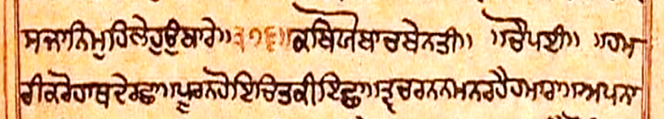
kab’yo baach beyn’tee. chau’payee.
Benti Chaupai: ‘Prayer-request’ written in verses of four by the Tenth Guru.
Notes:
126

Slide 127
hmrI kro hwQ dY rCw ]
pUrn hoie icq kI ieCw ]
Vaheguru! With Your Hand protect me & make my wish come true:
ham'ree karo, haath dai rashhaa.
poo'ran ho'e, chit kee ishhaa.
Notes:
127

Slide 128
qv crnn mn rhY hmwrw ]
Apnw jwn kro pRiqpwrw ]377]
May my mind stay in Your Presence & look after me as Your Own. ||377||
tav char'nan, man rehai hamaaraa.
ap’naa jaan, karo prat’paaraa. (377)
Notes:
128

Slide 129
hmry dust sBY qum Gwvhu ]
Awpu hwQ dY moih bcwvhu ]
Get rid all my bad thoughts & with Your Hand protect me.
ham’rey dush’t sabhai tum ghaa’vahu.
aap haath dai mo’eh bachaa’vahu.
Notes:
129

Slide 130
suKI bsY moro pirvwrw ]
syvk isK sBY krqwrw ]378]
My Creator! May my family live in peace, along with all the loving followers! ||378||
sukhee bas’sai mo’ro par’vaaraa.
sey’vak sikh sabhai kar’taaraa. (378)
Notes:
130

Slide 131
mo rCw inj kr dY kirXY ]
sB bYrn ko Awj sMGirXY ]
Please give me personal protection & get rid of all my bad thoughts today.
mo rachhaa, nij kar dai kar’yai.
sabh bai’ran, ko aaj sann’ghariyai.
Notes:
131

Slide 132
pUrn hoie hmwrI Awsw ]
qor Bjn kI rhY ipAwsw ]379]
May my wish come true that I always keep wanting to worship You. ||379||
poo’ran ho’e, hamaaree aa’saa.
tor bhajan kee, rehai pe’yaasaa. (379)
Notes:
132

Slide 133
qumih Cwif koeI Avru n iDXwaUN ]
jo br choN su qum qy pwaUN ]
May I never leave You to worship anyone else & always draw strength from You.
tum’eh chhaad, ko’ee avar naa Dhiyaa’oo^{N}.
jo bar cha’hau^{N}, so tum tey paa’oo^{N}.
Notes:
133

Slide 134
syvk isK hmwry qwrIAih ]
cuin cuin sqR hmwry mwrIAih ]380]
Save me with the loving followers & destroy my bad thoughts one by one. ||380||
sey’vak sikh hamaarey taaree’eh.
chun chun sat’r, hamaarey maaree’eh. (380)
Notes:
134

Slide 135
Awp hwQ dY muJY aubirXY ]
mrn kwl kw qRws invirXY ]
Giving me Your Hand, save me & get rid my fear of the time of death.
aap haath dai, mu’jhai u’bariyai.
maran kaal ka, traas ne’variyai.
Notes:
135

Slide 136
hUjo sdw hmwry pCw ]
sRI AisDuj jU kirXhu rCw ]381]
Always be my side. You are the Special Sword of Justice: Please protect me. ||381||
hoo’jo sadaa hamaarey pachhaa.
sree as’Dhuj joo, kar’yoh rachhaa. (381)
Notes:
136

Slide 137
rwiK lyhu muih rwKnhwry ]
swihb sMq shwie ipXwry ]
O my Protector, help me! O Master of the saints, You help those who love You.
raakh ley’hu, mu’eh raakhan’haarey.
saa’hib sant, sahaa’e pe’yaarey.
Notes:
137

Slide 138
dInbMDu dustn ky hMqw ]
qumho purI cqur ds kMqw ]382]
You are Friend of the weak, destroyer of the bad, & Master of the universe. ||382||
deen-bann’Dh, dush’ttan key hann’taa.
tum’ho puree, chatur das kann’taa. (382)
Notes:
138

Slide 139
kwl pwie bRhmw bpu Drw ]
kwl pwie isvjU Avqrw ]
Brahma & Shiva were both born and then had to die. So, only You alone can help me!
kaal paa'e, brah'maa bap Dharaa.
kaal paa'e, shiv'joo av'taraa.
Notes:
139
In the course of Time, Brahma took birth. When the Time ordained, Shiva was incarnated.

Slide 140
kwl pwie kr ibsnu pRkwsw ]
skl kwl kw kIAw qmwsw ]383]
Vishnu appeared & then dead. You created the world as a play with time limits. ||383||
kaal paa’e, kar bishan pra’kaashaa.
sakal kaal kaa, kee’aa tamaa’shaa. (383)
Notes:
140

Slide 141
jvn kwl jogI isv kIE ]
bydrwj bRhmw jU QIE ]
In Your play, Shiva chose to live simply & Brahma became an expert in studying.
javan kaal, jo’gee shiv kee’oh.
bey’d-raaj, brah’maa joo thee’oh.
Notes:
141
Within this play, Shiva’s story of becoming a Yogi, i.e. detached from worldliness, unfolded. This same play led Brahma to master the Vedic scriptures, seeking to understand its mysteries.

Slide 142
jvn kwl sB lok svwrw ]
nmskwr hY qwih hmwrw ]384]
In Your game all the universe is limited by Time. I bow to You, who makes this happen. ||384||
javan kaal, sabh lok savaaraa.
namas’kaar hai, taa’eh hamaaraa. (384)
Notes:
142
All the created worlds are fashioned by Vaheguru’s created divine cosmic (universal) play that is a game bound by time. I humbly bow before You, Vaheguru, (who made all this happen). ||384||

Slide 143
jvn kwl sB jgq bnwXO ]
dyv dYq jCn aupjwXo ]
Your play that created the universe, gave birth to the good, the bad, & the kind.
javan kaal, sabh jagat banaa’yoh.
dey’v dai^{N}’t, jachhan up’jaayo.
Notes:
143

Slide 144
Awid AMiq eykY Avqwrw ]
soeI gurU smiJXhu hmwrw ]385]
You alone stay the same from start till end of time. I accept You as my Guru. ||385||
aad ant, ey’kai av’taaraa.
so’ee guroo, sam’jheyoh hamaaraa. (385)
Notes:
144

Slide 145
nmskwr iqs hI ko hmwrI ]
skl pRjw ijn Awp svwrI ]
I only salute You, who has created all people and look after them.
namas’kaar, tis hee ko hamaaree.
sakal praj’jaa, jin aap savaaree.
Notes:
145

Slide 146
isvkn ko isvgun suK dIE ]
sqRün ko pl mo bD kIE ]386]
You give goodness & peace to followers & remove my bad thoughts in one go. ||386||
siv’kan ko, siv’gun sukh dee’oh.
sat’ran ko, pal mo baDh kee’oh. (386)
Notes:
146

Slide 147
Gt Gt ky AMqr kI jwnq ]
Bly bury kI pIr pCwnq ]
You know everything going inside all & know the troubles of the good & the bad.
ghatt ghatt key, ann’tar kee jaa’nat.
bhal’ley bu’rey kee, peer pachhaa’nat.
Notes:
147

Slide 148
cItI qy kuMcr AsQUlw ]
sB pr ik®pw idRsit kr PUlw ]387]
From a tiny ant to a big elephant - You look with kindness on all. ||387||
chee^{n}’tee tey, kunn’char as’thoolaa.
sabh par kripaa, drish’t kar foo’laa. (387)
Notes:
148

Slide 149
sMqn duK pwey qy duKI ]
suK pwey swDn ky suKI ]
Pain given to saints gives You pain & their happiness makes You happy.
sann'tan dukh, paa'ey tey du'khee.
sukh paa'ey, saa'Dhan key su'khee.
Notes:
149

Slide 150
eyk eyk kI pIr pCwnYN ]
Gt Gt ky pt pt kI jwnYN ]388]
You feel the pain of each person & know the deepest things in everyone’s heart. ||388||
ey'k ey’k kee, peer pashhaa’nai.
ghatt ghatt key, patt patt kee jaa'nai. (388)
Notes:
150

Slide 151
jb audkrK krw krqwrw ]
pRjw Drq qb dyh Apwrw ]
When You use Your Creative Power, countless people take on bodies.
jab ud'karakh karaa kar'taaraa.
praj'jaa Dharat, tab deh a'paaraa.
Notes:
151

Slide 152
jb AwkrK krq ho kbhUM ]
qum mY imlq dyh Dr sBhUM ]389]
When You use Your Destructive Power, all life will merge back into You. ||389||
jab aa'karakh, karat ho kab'hoo^{N}.
tum mai milat, deh Dhar sabh'hoo^{N}. (389)
Notes:
152

Slide 153
jyqy bdn isRsit sB DwrY ]
Awpu AwpnI bUJ aucwrY ]
All life in the world with bodies describe You using their own thoughts.
jey'tey badan, srish’t sabh Dhaa'rai.
aap aap'nee, boojh u’chaarai.
Notes:
153

Slide 154
qum sBhI qy rhq inrwlm ]
jwnq byd Byd Ar Awlm ]390]
You remain unstuck to everyone. The wise understand this mystery of Yours. ||390||
tum sabh’hee tey, rehat ne’raalam.
jaa'nat bey’d, bhey’d ar aa'lam. (390)
Notes:
154

Slide 155
inrMkwr inRibkwr inrlµB ]
Awid AnIl Anwid AsMB ]
You have no shape, badness, any need, colour, or start, and exists by Yourself.
nirunn'kaar, nribi'kaar, nir-lamm’bh.
aad a'neel, a'naad a-samm’bh.
Notes:
155

Slide 156
qw kw mUVH aucwrq Bydw ]
jw kO Byv n pwvq bydw ]391]
Foolish people claim to know Your secrets. Even the Vedas don’t understand. ||391||
taa kaa mooR, u'chaarat bhey'daa
jaa kau bhey’v, naa paa'vat bey'daa. (391)
Notes:
156

Slide 157
qw kO kir pwhn Anumwnq ]
mhw mUVH kCu Byd n jwnq ]
Anyone who thinks You are a stone-statue is great fool who lacks understanding.
taa kau kar, paa'han anu’maanat.
mahaa mooR, kachh bhey’d naa jaa’nat.
Notes:
157

Slide 158
mhwdyv ko khq sdw isv ]
inrMkwr kw cInq nih iBv ]392]
Anyone who says Shiva is You, lacks true knowledge of You. ||392||
mahaa-dey’v ko, kehat sadaa shiv.
nirunn'kaar kaa, chee'nat neh bhiv. (392)
Notes:
158

Slide 159
Awpu AwpnI buiD hY jyqI ]
brnq iBMn iBMn quih qyqI ]
Every person describes in different ways according to their own understanding.
aap aap'nee, buDh hai jey'tee.
bar'nat, bhinn bhinn, tu'eh tey'tee.
Notes:
159

Slide 160
qumrw lKw n jwie pswrw ]
ikh ibiD sjw pRQm sMswrw ]393]
No one knows Your creation’s limits, nor how the Universe was first created. ||393||
tum'raa lakhaa naa jaa'e, pasaaraa.
keh biDh sajaa, pratham sann’saaraa. (393)
Notes:
160

Slide 161
eykY rUp AnUp srUpw ]
rMk BXo rwv khI BUpw ]
You have beauty like no other & play different roles in a poor person & in a king.
ey'kai roop, a'noop saroopaa.
rann’k bheyo, raav kehee bhoo'paa.
Notes:
161

Slide 162
AMfj jyrj syqj kInI ]
auqBuj Kwin bhur ric dInI ]394]
You are amazing that You create life born from eggs, sweat, earth & foetus. ||394||
ann'ddaj jey'raj, sey'taj kee'nee.
ut bhuj khaan, bahur rach dee'nee. (394)
Notes:
162

Slide 163
khUM PUl rwjw hÍY bYTw ]
khUM ismit iBXo sMkr iekYTw ]
At times You sit as the Creator, & at times You as the Destroyer of the world.
kahoo^{N} fool raa’jaa, hai’wai bai'tthaa.
kahoo^{N} simatt, bheyo sann’kar e’kaitthaa.
Notes:
163

Slide 164
sgrI isRsit idKwie AcMBv ]
Awid jugwid srUp suXMBv ]395]
You show wonders to all the creation & are the Start of Time, beautiful & rely on none. ||395||
sag'ree srish’t, dikhaa'e achamm'bhav.
aad ju'gaad, saroop suyamm’bhav. (395)
Notes:
164

Slide 165
Ab rCw myrI qum kro ]
isK aubwir AisK sMGro ]
Please protect me now. Give me the Sikh way of thinking & get rid of other thinking.
ab rachhaa, mey’ree tum karo.
sikh u’baar, a'sikh sann'gharo.
Notes:
165

Slide 166
dust ijqy auTvq auqpwqw ]
skl mlyC kro rx Gwqw ]396]
In this battle of life, make my trouble making bad thoughts & wants go away. ||396||
dush’tt jitey, utth’vat ut’paataa.
sakal malechh, karo raN ghaa’taa. (396)
Notes:
166

Slide 167
jy AisDuj qv srnI pry ]
iqn ky dust duiKq hÍY mry ]
You are the Sword of Peace! Whoever takes Your protection, their bad thoughts die.
jey as'Dhuj, tav shar'nee parey.
tin key dush’tt, du'khit hai'wai marey.
Notes:
167

Slide 168
purK jvn pg pry iqhwry ]
iqn ky qum sMkt sB twry ]397]
You remove all the troubles of those who lovingly fall at Your Feet. ||397||
pu'rakh javan, pag parey te’haarey.
tin key tum, sann’katt sabh ttaarey. (397)
Notes:
168

Slide 169
jo kil ko iek bwr iDAY hY ]
qw ky kwl inkit nih AYhY ]
Meditating on You even once with true love the fear of death doesn’t come near you.
jo kal ko, ek baar Dhe’yai hai.
taa key kaal, nikatt neh ai’hai.
Notes:
169

Slide 170
rCw hoie qwih sB kwlw ]
dust Airst tryN qqkwlw ]398]
They are protected at all times & have all their troubles removed in an instant. ||398||
rachhaa ho’e, taa’eh sabh kaalaa.
dush’tt arish’tt, ttarey tat’kaalaa. (398)
Notes:
170

Slide 171
ik®pw idRsit qn jwih inhirho ]
qw ky qwp qnk mo hirho ]
Whoever receives Your kind blessings, has their troubles taken away in an instant.
kripaa drish’tt, tan jaa’eh ne’hariho.
taa key taap, tanak mo har’ho.
Notes:
171

Slide 172
iriD isiD Gr mo sB hoeI ]
dust Cwh CÍY skY n koeI ]399]
Special powers come inside their body & no bad thing can come near their shadow. ||399||
riDh siDh, ghar mo sabh ho’ee.
dush’tt chhaah, chh’wai sak’ai na ko’ee. (399)
Notes:
172

Slide 173
eyk bwr ijn qumY sMBwrw ]
kwl Pws qy qwih aubwrw ]
Remembering You with love, even once, one gets saved from the hold of death.
ey’k baar, jin tum’ai samm’bhaaraa.
kaal faa^{n}s tey, taa’eh u’baaraa.
Notes:
173

Slide 174
ijn nr nwm iqhwro khw ]
dwird dust doK qy rhw ]400]
Those who meditate on Your Name, overcome poverty, suffering & problems. ||400||
jin nar naam, te’haaro kahaa.
daa’rid dush’tt, doh’k tey rahaa. (400)
Notes:
174

Slide 175
KVgkyqu mY srix iqhwrI ]
Awp hwQ dY lyhu aubwrI ]
I come to Your protection whose flag has the Sword of Justice. Please protect me.
khaRag-key’t, mai sharaN te’haaree.
aap haath dai, ley’hu u’baaree.
Notes:
175

Slide 176
srb TOr mo hohu shweI ]
dust doK qy lyhu bcweI ]401]
Give me Your help wherever I am & save me from bad things & thoughts. ||401||
sarab tthaur, mo ho’hu sahaa’ee.
dush’tt doh’k tey, ley’hu bachaa’ee. (401)
Notes:
176

Slide 177
swai'yaa.
sÍYXw ]
Poetic verse.

Slide 178
paa^{n}’e gehey, jab tey tum’rey, tab tey ko’oo aa^{N}kh, tarey nehee aa’nayo.
pWie ghy jb qy qumry
qb qy koaU AWK qry nhIN AwnXo ]
Vaheguru! Since I have held on to You, I don’t look at anyone else for help.

Slide 179
raam raheem, puraan ku’raan, a-ney’k kehai mat, ey’k na maa’nayo.
rwm rhIm purwn kurwn
Anyk khYN mq eyk n mwnXo ]
I don’t follow the different beliefs of the Puraans, Quran, Rama or other prophets.

Slide 180
simm’rit shaastar, bey’d sabh’ai, bahu bhey’d kehai, ham ey’k naa jaa’nayo.
isMimRq swsqR byd sBY
bhu Byd khYN hm eyk n jwnXo ]
I don’t accept any belief found in the books of the Simritis, Shastars or Vedas.

Slide 181
sree as’paan, kripaa tum’ree kar, mai na keh’yo, sabh to’eh bakhaan’yo.
sRI Aispwn ik®pw qumrI kir
mY n khXo sB qoih bKwnXo ]863]
Vaheguru! O Sword of Justice! Everything said is with Your blessings alone. ||863||

Slide 182
doh’raa.
dohrw ]
Two-lined poetic verse.

Slide 183
sagal du'aar kau, chhaad kai, geh'yoh, tu'haaro du’aar.
sgl duAwr kau Cwif kY
gihE quhwro duAwr ]
Having given up going to other doors for help, I chosen to come to Your door.

Slide 184
baa^{n}’eh geh’hey kee, laaj ass, gobind, daas tu’haar.
bWih ghy kI lwj As
goibMd dws quhwr ]864]
O Vaheguru! Please hold my arm & protect me for I am Your humble servant. ||864||

Slide 185
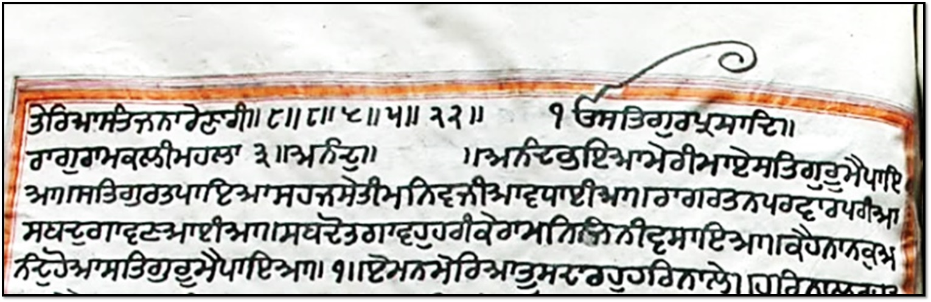
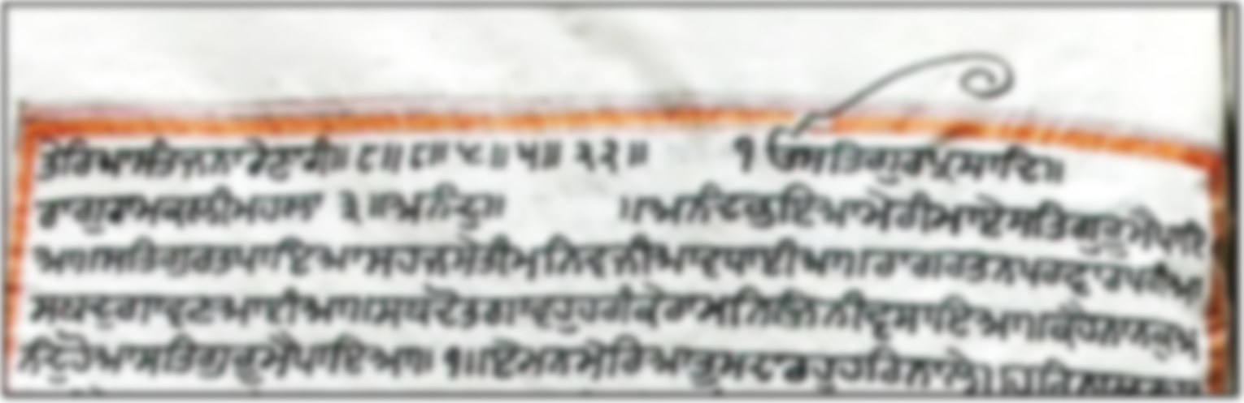
There’s One Ultimate Power who is the Truth & the Giver of Wisdom & Blessings:
Written in Raamkalee (emotion of being corrected by a teacher) by the Third Guru:
Anand ~ The Song Of Bliss
ikk o’ann-kaar sat, gur’prasaad.
raag raam’kalee, mahalla tee’jaa, a’nand.
Notes:
185

Slide 186
Anµdu BieAw myrI mwey
siqgurU mY pwieAw ]
Dear intelligence! Finding the True Guru, I have found true happiness.
a’nand bheyaa, mey’ree maa’e,
sat’guroo mai paa’yaa.
Notes:
186

Slide 187
siqguru q pwieAw shj syqI
min vjIAw vwDweIAw ]
The Guru helped me find peace inside me & now happiness flows within my mind.
sat’gur ta, paa’yaa sehaj sey’tee,
man vajee’yaa^{n} vaa’Dhaaee’yaa^{n}.
Notes:
187

Slide 188
rwg rqn prvwr prIAw
sbd gwvx AweIAw ]
It feels like within me beautiful music & tunes are singing Gurbani.
raag ratan par’vaar paree’yaa^{n},
shabad gaa’vaN aaee’yaa^{n}.
Notes:
188

Slide 189
sbdo q gwvhu hrI kyrw
min ijnI vswieAw ]
Those who fill their mind with Vaheguru, sing Gurbani.
shab’do ta gaa’vahu haree key’raa,
man jinnee vasaa’yaa.
Notes:
189

Slide 190
khY nwnku Anµdu hoAw
siqgurU mY pwieAw ]1]
Guru Ji says: I found true happiness finding the True Guru. ||1||
kehai naa’nak, a’nand ho’aa,
sat’guroo mai paa’yaa. (1)
Notes:
190

Slide 191
ey mn myirAw
qU sdw rhu hir nwly ]
Dear mind! Always stay with Vaheguru.
ey man mey’riyaa,
too sadaa rahu har naa’ley.
Notes:
191

Slide 192
hir nwil rhu qU mMn myry
dUK siB ivswrxw ]
Always staying with Vaheguru you will forget all your pains.
har naal rahu, too mann mey’rey,
dookh sabh visaar’Naa.
Notes:
192

Slide 193
AMgIkwru Ehu kry qyrw
kwrj siB svwrxw ]
Vaheguru will help you in completing all tasks.
angee’kaar, oh’hu karey tey’raa,
kaa’raj sabh savaar’Naa.
Notes:
193

Slide 194
sBnw glw smrQu suAwmI
so ikau mnhu ivswry ]
Why forget the Powerful Master who can make anything happen?
sabh’naa galaa^{n}, sam’rath su’aamee,
so k’yo man’hu visaarey.
Notes:
194

Slide 195
khY nwnku mMn myry
sdw rhu hir nwly ]2]
Guru Ji says: O dear mind! Always stay with Vaheguru. ||2||
kehai naa’nak, mann mey’rey,
sadaa rahu har naa’ley. (2)
Notes:
195

Slide 196
swcy swihbw
ikAw nwhI Gir qyrY ]
True Master! There is nothing that you don’t have in Your House!
saa’chey saa’hibaa,
k’yaa naa’hee ghar tey’rai.
Notes:
196

Slide 197
Gir q qyrY sBu ikCu hY
ijsu dyih su pwvey ]
Your House has everything, but we only get when You give.
ghar ta tey’rai, sabh kichh hai,
jis deh su paa’veye.
Notes:
197

Slide 198
sdw isPiq slwh qyrI
nwmu min vswvey ]
Those who fill their mind with Your Sound, always sing Your Praises.
sadaa sifat, salaah tey’ree,
naam man vasaa’veye.
Notes:
198

Slide 199
nwmu ijn kY min visAw
vwjy sbd Gnyry ]
Filling the mind with Your Sound, is like hearing countless beautiful instruments.
naam jin kai, man vas’yaa,
vaa’jey shabad ghaney’rey.
Notes:
199

Slide 200
khY nwnku scy swihb
ikAw nwhI Gir qyrY ]3]
Guru Ji says: Vaheguru! There is nothing that you don’t have in Your House! ||3||
kehai naa’nak, sachey saa’hib,
k’yaa naa’hee ghar tey’rai. (3)
Notes:
200

Slide 201
  swcw nwmu myrw AwDwro ]
swcu nwmu ADwru myrw ijin BuKw siB gvweIAw ]
Vaheguru’s Name is my help & food for my soul that gets rid of all my different wants.
saa’chaa naam mey’raa aa’Dhaaro.
saach naam, a’Dhaar mey’raa,
jin bhukh’aa^{n}, sabh gavaaee’yaa^{n}.
Notes:
201

Slide 202
kir sWiq suK min Awie visAw
ijin ieCw siB pujweIAw ]
I get peace & comfort with Your Sound in my mind & You fulfil all my wishes.
kar shaa^{n}t sukh man aa’e vas’yaa,
jin ichhaa sabh pujaaee’yaa^{n}.
Notes:
202

Slide 203
sdw kurbwxu kIqw gurU ivthu
ijs dIAw eyih vifAweIAw ]
I forever adore the Guru who has these great powers.
sadaa kur’baaN kee’taa, guroo vitt’hu,
jis dee’aa^{n} ey’eh vad’yaaee’yaa^{n}.
Notes:
203

Slide 204
khY nwnku suxhu sMqhu sbid Drhu ipAwro ]
swcw nwmu myrw AwDwro ]4]
Guru Ji says: Listen, saints love Gurbani. Vaheguru’s Name is my help . ||4||
kehai naanak, suN’hu sant’hu, shabad Dhar’hu piyaaro.
saa’chaa naam mey’raa aa’Dhaaro.
Notes:
204

Slide 205
vwjy pMc sbd iqqu Gir sBwgY ]
Gir sBwgY sbd vwjy klw ijqu Gir DwrIAw ]
The five positive emotions play inside the lucky one who’s received the power of Naam.
vaajey panch shabad, tit ghar sabhaagai.
ghar sabhaagai shabad vaajey, kalaa jit ghar Dhaaree’aa.
Notes:
205

Slide 206
pMc dUq quDu vis kIqy
kwlu kMtku mwirAw ]
They control their ‘five negative emotions’ & kill their fear of death being scary.
pann’ch doot, tuDh vass kee’tey,
kaal kann’ttak maar’yaa.
Notes:
206

Slide 207
Duir krim pwieAw quDu ijn kau
is nwim hir kY lwgy ]
Only those You have been blessed by You are lucky to be connected with Your Sound.
Dhur karam paa'yaa, tuDh jin kau,
se naam har kai laa'gey.
Notes:
207

Slide 208
khY nwnku qh suKu hoAw
iqqu Gir Anhd vwjy ]5]
Guru Ji says: They enjoy peace & Kirtan automatically plays within their hearts. ||5||
kehai naa’nak, teh sukh ho’aa,
tit ghar an’had vaajey. (5)
Notes:
208

Slide 209
AnMdu suxhu vfBwgIho
sgl mnorQ pUry ]
The lucky ones listen to the teachings of Anand Sahib to complete their goals.
a’nand suN’hu, vad’bhaagee’ho,
sagal manorath poorey.
Notes:
209

Slide 210
pwrbRhmu pRBu pwieAw
auqry sgl ivsUry ]
Connecting with Vaheguru they forget all their worries.
paar’brahm prabh paa’yaa,
ut’rey, sagal visoorey.
Notes:
210

Slide 211
dUK rog sMqwp auqry
suxI scI bwxI ]
Troubles, illnesses & pains go away of those who truly listen to Gurbani.
dookh rog, sann’taap ut’rey,
su’Nee sachee baa’Nee.
Notes:
211

Slide 212
sMq swjn Bey srsy
pUry gur qy jwxI ]
The saintly Gurmukhs who learn from the Perfect Guru fill their souls with joy.
sann’t saa’jan bheye sar’sey
poo’rey gur tey jaa’Nee.
Notes:
212

Slide 213
suxqy punIq khqy pivqu
siqguru rihAw BrpUry ]
The listeners & readers of Gurbani become purified & begin to see Guru Ji everywhere.
suN’tey pu’neet, keh’tey pavit,
sat’gur reh’yaa bhar’poorey.
Notes:
213

Slide 214
ibnvMiq nwnku gur crx lwgy
vwjy Anhd qUry ]40]1]
Guru Ji says: Linking with the Guru, Kirtan automatically plays within the heart. ||40||1||
bin’vant naa’nak, gur charaN laa’gey,
Vaa’jey an’had too’rey. (40)(1)
Notes:
214

Slide 215
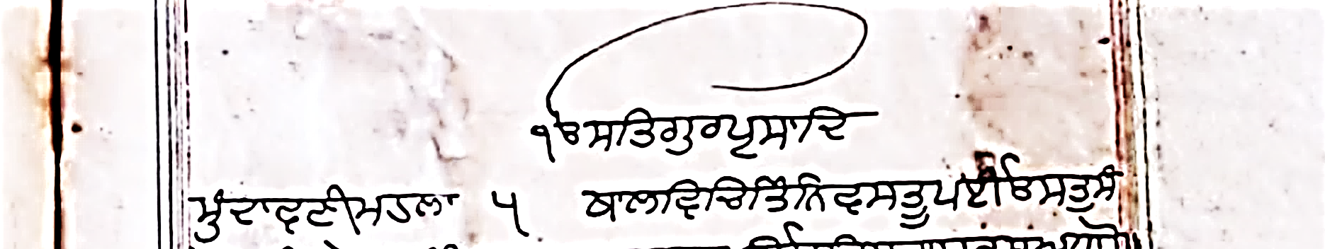
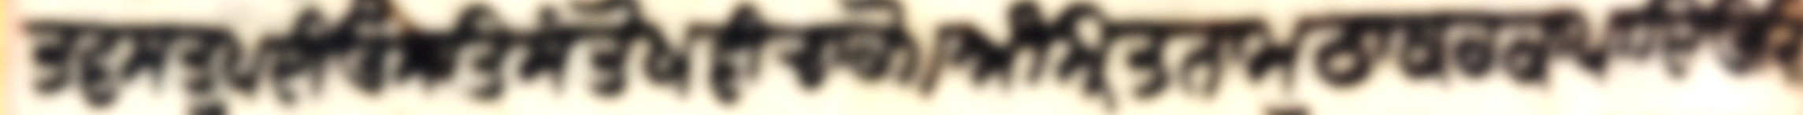
There’s One Ultimate Power who is the Truth & the Giver of Wisdom & Blessings:
Mundaavanee (the Final Seal),
By the Fifth Guru:
ikk o’ann-kaar sat, gur’prasaad.
munn’daavaNee, mahallaa panj’vaa.

Slide 216
thaal vich, tin vas’too peyee’oh, sat sann’tokh vee’chaaro.
Qwl ivic iqMin vsqU peIEN
squ sMqoKu vIcwro ]
Within Sri Guru Granth Sahib Ji, You have placed Truth, Contentment & Wisdom.

Slide 217
amm’rit naam, tthaa’kur kaa peye’oh, jis kaa sabhas a’Dhaaro.
AMimRq nwmu Twkur kw pieE
ijs kw sBsu ADwro ]
You have also placed in it Your Sound that gives life to the soul & supports everything.

Slide 218
jey ko khaa’vai, jey ko bhunn’chai, tis kaa ho’e u’Dhaaro.
jy ko KwvY jy ko BuMcY
iqs kw hoie auDwro ]
In this world, those will be saved who eat & enjoy this food of the soul.

Slide 219
ey’h vas’t, tajee neh jaa’ee, nit nit, rakh ur Dhaa’ro.
eyh vsqu qjI nh jweI
inq inq rKu auir Dwro ]
Never let go of the food of the soul & always keep it carefully in your mind.

Slide 220
tam sann’saar, charan lag taree’yai, sabh naa’nak brah’m pasaaro. (1)
qm sMswru crn lig qrIAY
sBu nwnk bRhm pswro ]1]
Holding on to Gurbani one is saved from the world & Your Light seen everywhere. ||1||

Slide 221
salok, mahallaa panj’vaa.
slok mhlw 5 ]
Verse by the Fifth Guru:

Slide 222
tey’raa kee’taa, jaa’toh naa’hee, mai’noh jog kee’toee.
qyrw kIqw jwqo nwhI
mYno jogu kIqoeI ]
Make me appreciate You, as I’ve not been grateful for what You’ve done for me.

Slide 223
mai nirguN’yaarey, ko guN naa’hee, aa’pey taras peyoh’ee.
mY inrguixAwry ko guxu nwhI
Awpy qrsu pieEeI ]
You’ve shown me kindness even though I might not deserve it or have any good.

Slide 224
taras peyaa, mih’raamat ho’ee, sat’gur sajaN mil’yaa.
qrsu pieAw imhrwmiq hoeI
siqguru sjxu imilAw ]
Showing my kindness, You blessed me with a best Friend, who is the True Guru.

Slide 225
naa’nak, naam mil’ai, taa^{n} jee’vaa^{n}, tan man thee’vai har’yaa. (1.2.)
nwnk nwmu imlY qW jIvW
qnu mnu QIvY hirAw ]1]2]
Connecting with Your Sound my mind & body come to life with joy. ||1||2 ||

Slide 226
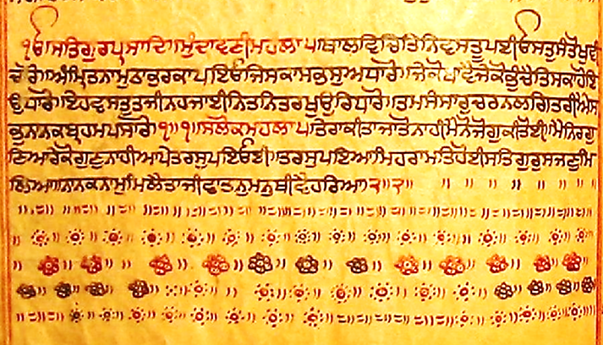
vwihgurU jI kw Kwlsw!
vwihgurU jI kI Pqih!

Slide 227
pau’Ree
pauVI ]
Verse:

Slide 228
tith'ai too sam’rath, jith’ai ko'e naa'eh. oh’thai tey’ree rakh, ag’nee udar maa'eh.
iqQY qU smrQu ijQY koie nwih ]
EQY qyrI rK AgnI audr mwih ]
You are there, where no one else can be, protecting us in the fire like heat of the womb.

Slide 229
suN kai jam key doot, naa'e tey'rai chhad jaa'eh. bhau'jal bikham as'gaah, gur shab'dee paar paa'eh.
suix kY jm ky dUq nwie qyrY Cif jwih ]
Baujlu ibKmu Asgwhu gur sbdI pwir pwih ]
Hearing Your Name, fear of death goes. With Gurbani, one passes life that seems scary.

Slide 230
jin kau lagee piyaas, amm'rit sey'e khaa'eh. kal meh ey'ho punn, guN go’vind gaa'eh.
ijn kau lgI ipAws AMimRqu syie Kwih ]
kil mih eyho puMnu gux goivMd gwih ]
Those live off Your soul-food who want it. In this time, the best action is to Praise You.

Slide 231
sabh’sai no kir’paal, samaaley saa’eh saa’eh. bir’thaa ko’e na jaa’e, je aa’vai tuDh aa'eh. (9)
sBsY no ikrpwlu sm@wly swih swih ]
ibrQw koie n jwie ij AwvY quDu Awih ]9]
O Kind One! You look after us with each breath. Coming to You, no one goes empty. ||9||

Slide 232
salok, mahallaa panj’vaa.
sloku mÚ 5 ]
Verse by the Fifth Guru:

Slide 233
ann’tar, gur aa’raaDh'Naa, jih’vaa, jap gur naa’o.
AMqir guru AwrwDxw
ijhvw jip gur nwau ]
Inside yourself, focus on the Guru & with your tongue chant Vaheguru’s Name.

Slide 234
ney’tree^{n}, sat’gur pey’kh-Naa, srav’Nee, sun’Naa gur naa’o.
nyqRI siqguru pyKxw
sRvxI sunxw gur nwau ]
With your eyes look at Gurbani & with your ears hear the Sound of the Guru.

Slide 235
sat’gur sey’tee rat’yaa, dar’gah paaee’yai tthaa’o.
siqgur syqI riqAw
drgh pweIAY Twau ]
Becoming absorbed in the Guru, you will get a place of respect in Vaheguru’s House.

Slide 236
kahu naa’nak, kir’paa karey, jis no ey’h vath dey'e.
khu nwnk ikrpw kry
ijs no eyh vQu dyie ]
Vaheguru Ji gives to those who catch their Kind attention.

Slide 237
jag meh u’tam kaa^{n}’Dhee’eh, vir’ley key’ee key’e. (1)
jg mih auqm kwFIAih
ivrly kyeI kyie ]1]
The few such people are known as great in this world. ||1||

Slide 238
mahallaa panj'vaa
mÚ 5 ]
By the Fifth Guru:

Slide 239
rakhey rakhan’haar, aap u’baariyan. gur kee pai’ree paa’e, kaaj savaa’riyan.
rKy rKxhwir Awip aubwirAnu ]
gur kI pYrI pwie kwj svwirAnu ]
Save us, O Protector. Falling at the feet of the Guru, our tasks are completed with success.

Slide 240
ho’aa aap dayaal, man’hu na visaa’riyan. saaDh janaa kai sann’g, bhav’jal taa’riyan.
hoAw Awip dieAwlu mnhu n ivswirAnu ]
swD jnw kY sMig Bvjlu qwirAnu ]
With Your kindness we don’t forget You. With the Sangat’s help we get through life.

Slide 241
saa’kat, ninn'dak, dush’tt, khin maa’eh bidaa’riyan.
swkq inMdk dust
iKn mwih ibdwirAnu ]
You can get rid of our faithless, bad, & evil thinking in an instant.

Slide 242
tis saahib kee ttey’k, naa’nak mann’ai maa’eh. jis sim’rat sukh ho’e, sag’ley dookh jaa’eh. (2)
iqsu swihb kI tyk nwnk mnY mwih ]
ijsu ismrq suKu hoie sgly dUK jwih ]2]
In your mind take the help of the Master who gives happiness & pains go away. ||2||

Slide 243
too tthaakur tum peh ar’daas.
jee’o pinn’d sabh tey’ree raas.
tum maat pitaa ham baarik tey’rey.
tum’ree kripaa meh sookh ghanerey.
ko’e na jaa’Nai tum’raa ann’t.
oo’chey tey oo’chaa bhag’vant.
sagal samag’ree tum’rai sootar Dhaaree.
tum tey ho’e su aagiyaa’kaaree.
tum’ree gat mit tum hee jaa’Nee.
naa’nak daas sad’aa kur’baaNee. (8)(4)

Slide 244


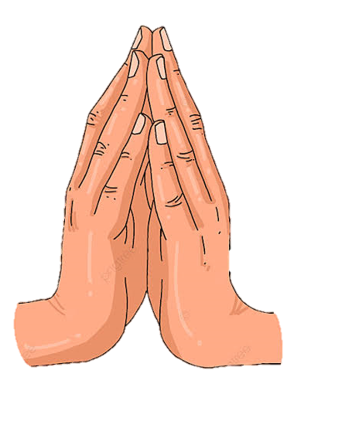


P O W E R & B L E S S I N G S
2) Panj Pyaare, Four Sahibzaade & devoted Sikhs
3) Shaheed Singhs & Singhnian (Sikh martyrs)
VAHEGURU
VAHEGURU
VAHEGURU
VAHEGURU
1) Vaheguru Ji, Ten Gurus, & Sri Guru Granth Sahib Ji
4) Panj Takhat (seats of authority) & all Gurdwaras
P R A Y E R O F S I K H N A T I O N
1) Prayer for Khalsa:
  Simran
  Protection
  Fulfil duty
  Positive influence
2) Prayer - 7 gifts:
Sikhi, unshorn hair, discipline, wisdom, trust, faith & Naam
3) Prayer for Sikhs:
May the mind remain humble & wisdom high
4) Prayer:
Freely able to visit & manage all Gurdwaras

