Slide 1
A guide to the Sikh celebration of
Vaisakhi
A time to reflect and celebrate
🌱 Renewal 🤝 Trust 🌼 Awakening

Slide 2
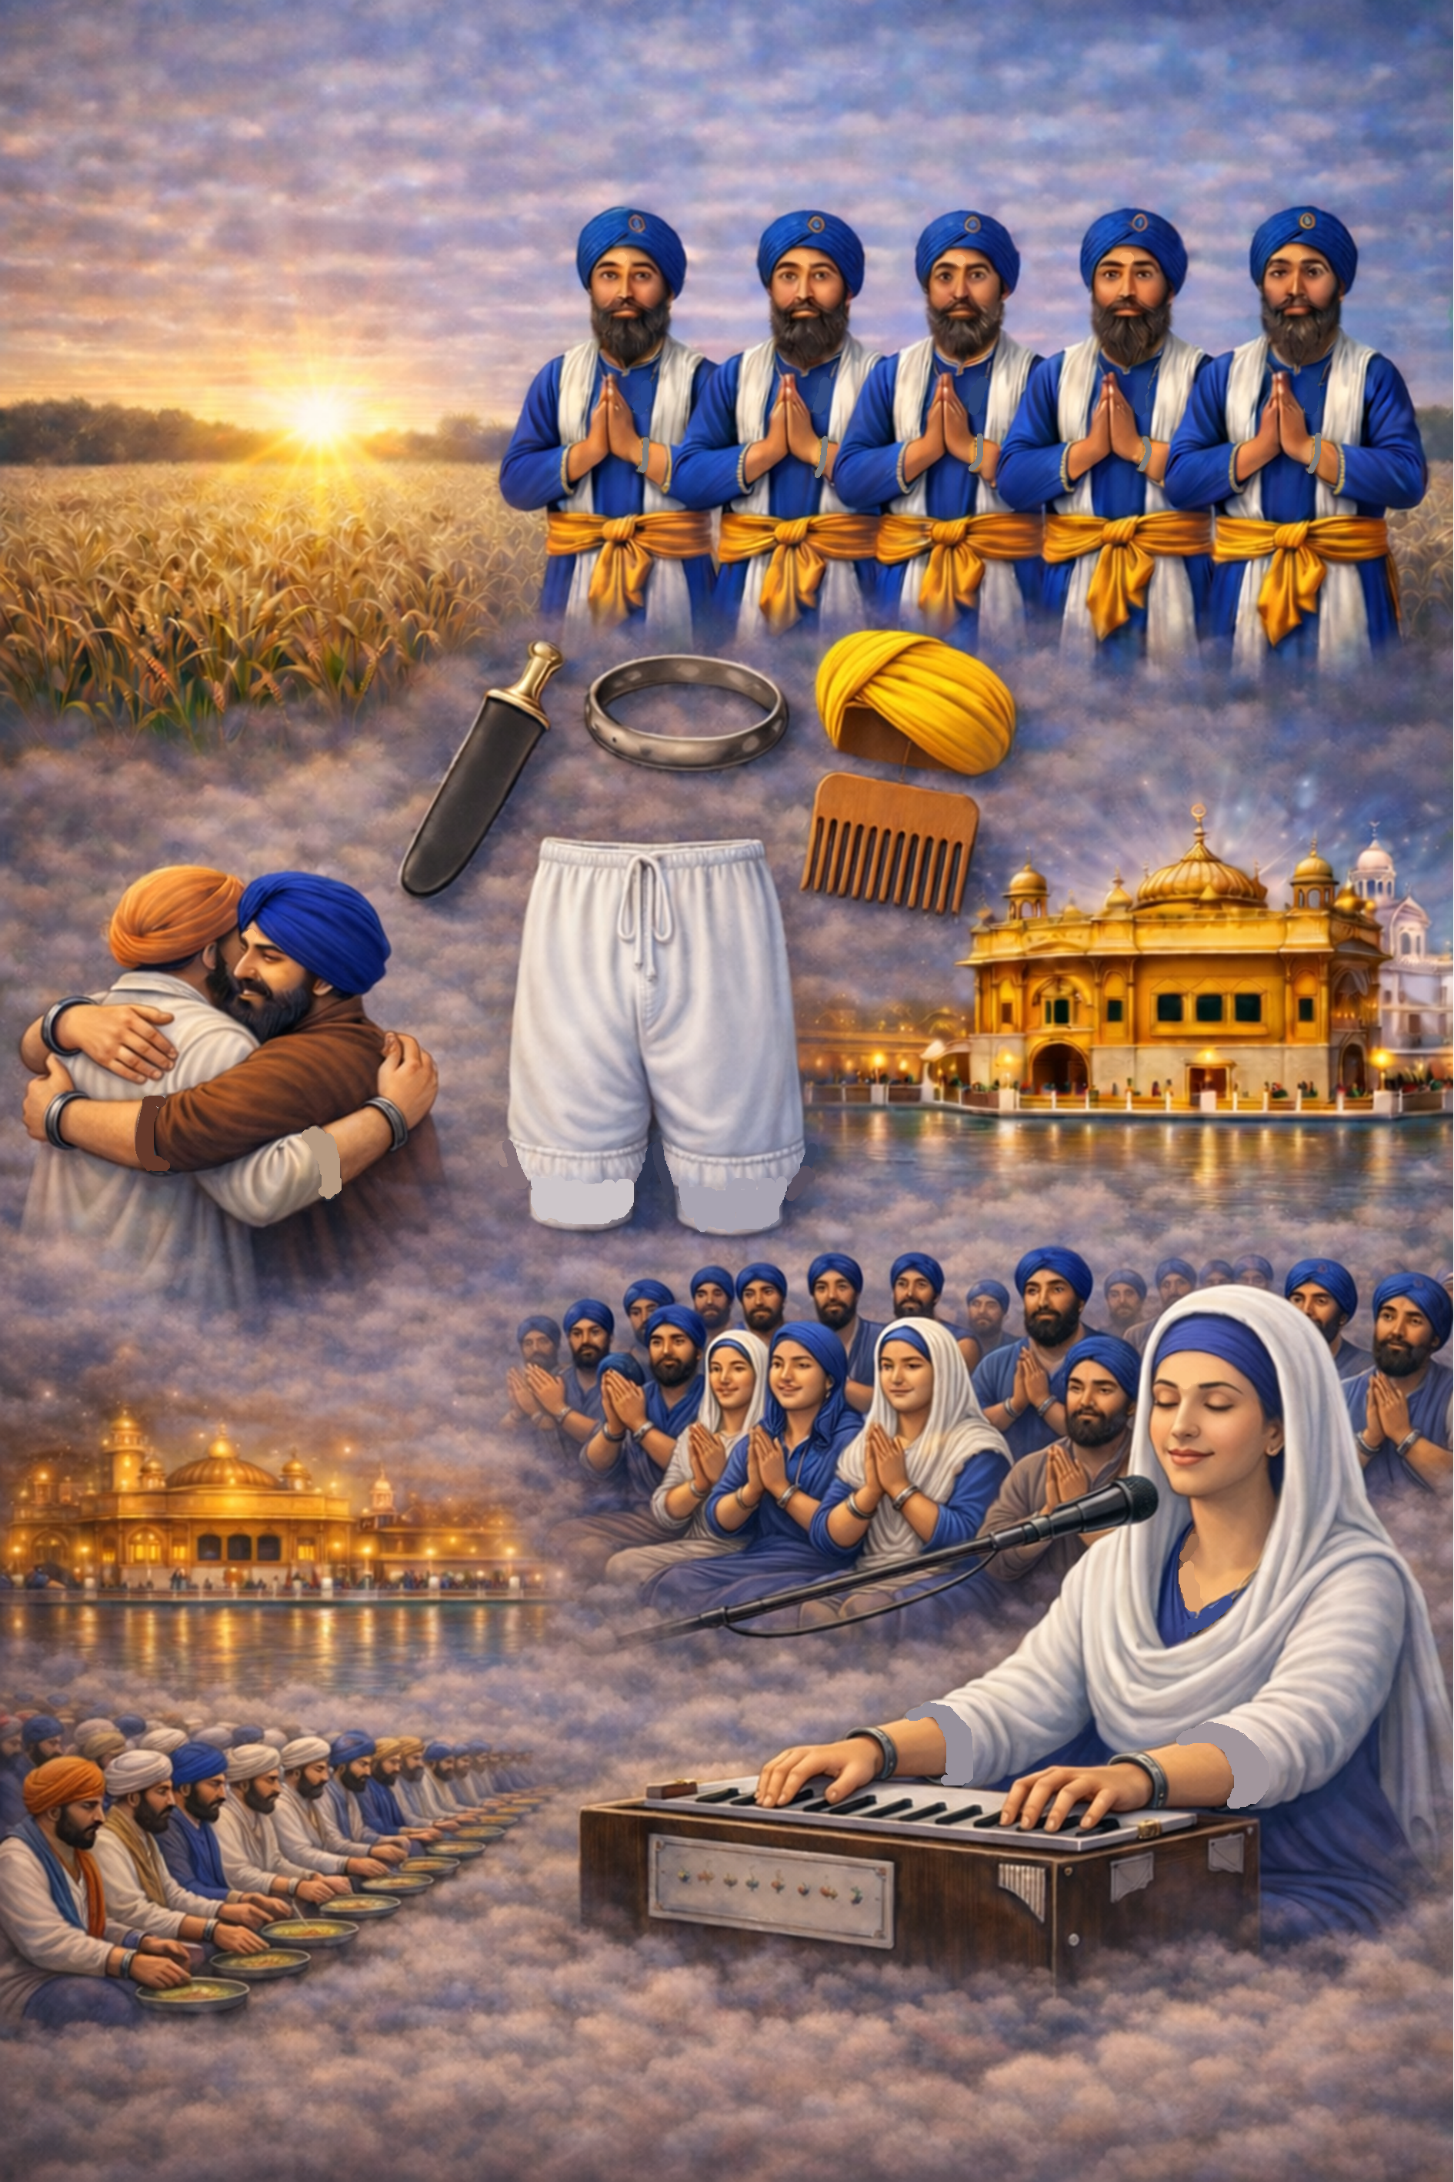
As we welcome the spring season, we reflect on the significance of Vaisakhi, an important Sikh festival that falls on 14th April.
In Sikhi (the Sikh faith), it is a time of honouring and celebrating renewal, trust, spiritual awakening, & commitment.

Slide 3
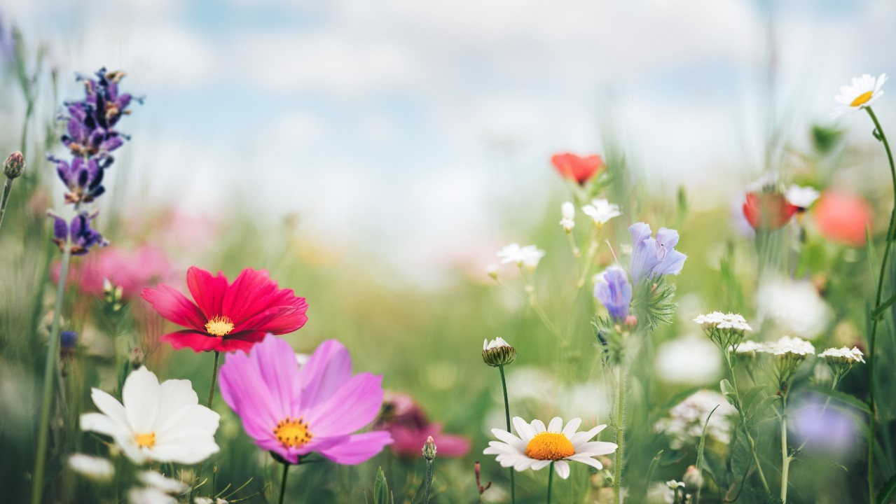

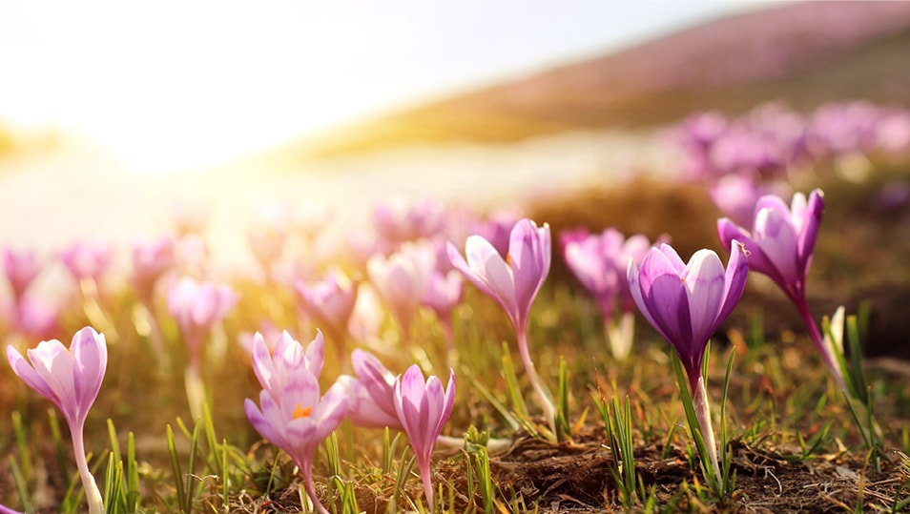
VAISAKHI:
USING NATURE AS A SPIRITUAL REFLECTION
Vaisakhi celebrates the new beginnings of nature, acting as a reminder for us that growth & fresh beginnings for us are always possible.
It marks a time when nature blossoms again, encouraging us to reflect on our own renewal and purpose.
As the earth awakens in this time of year, Vaisakhi invites us to reflect & reconnect with what sustains and inspires us.

Slide 4
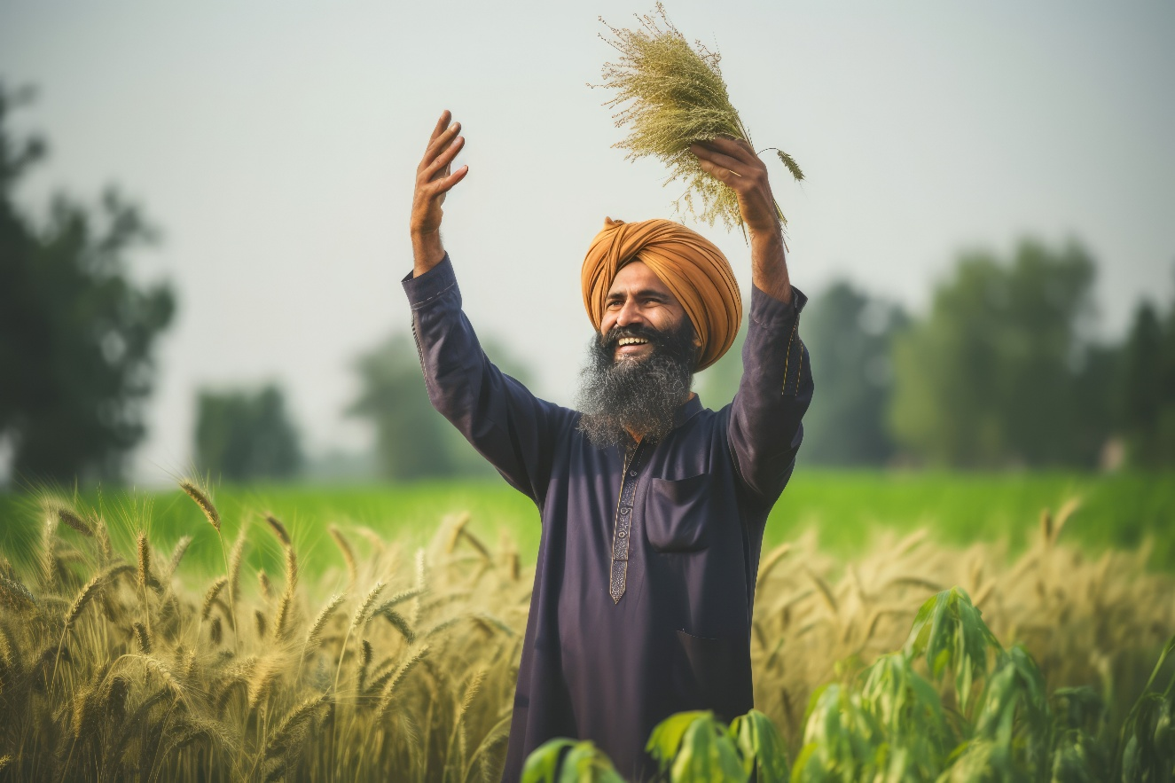
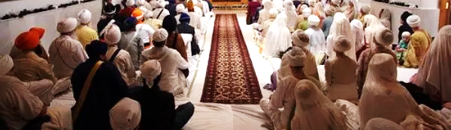
VAISAKHI:
CELEBRATING COMMUNITY & CONNECTION
Culturally, Vaisakhi is a harvest festival, marked for centuries with carnivals (Melas) where abundance is celebrated.
The Third Sikh Guru made Vaisakhi an official festival, which also marks Satguru Nanak Ji, the Divine Revealed, arrival in this world.
For Sikhs, the Third Guru declared Vaisakhi as a Jorr‑Mela – a time connect higher with oneself, community, & the Divine.

Slide 5
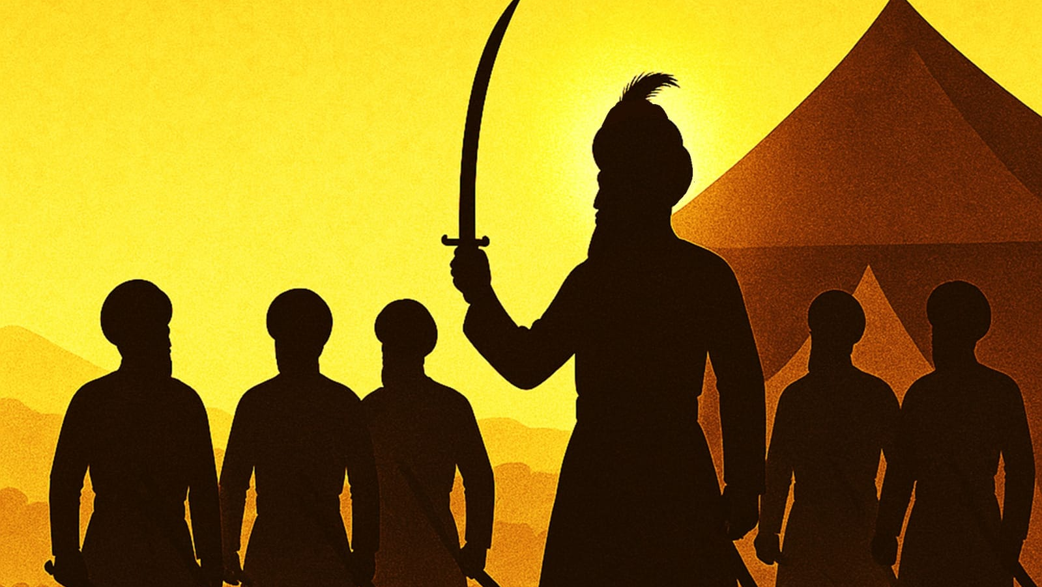
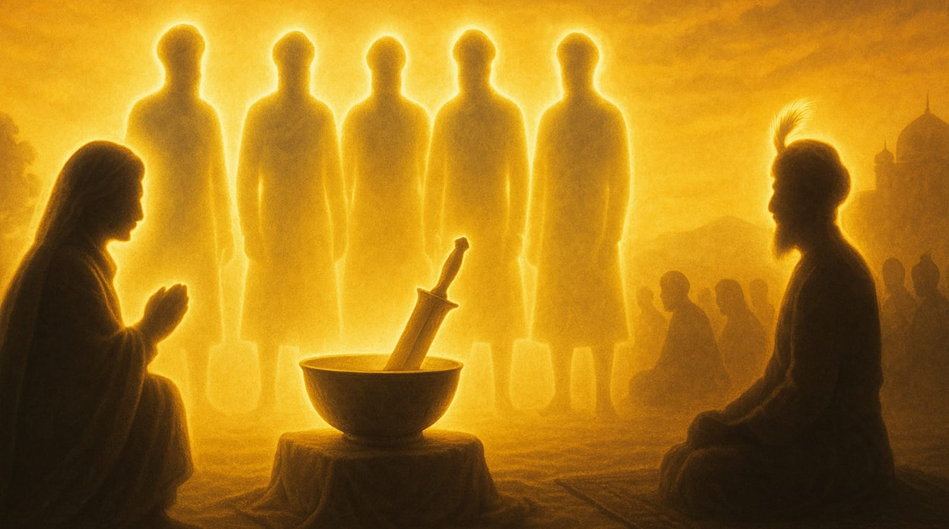
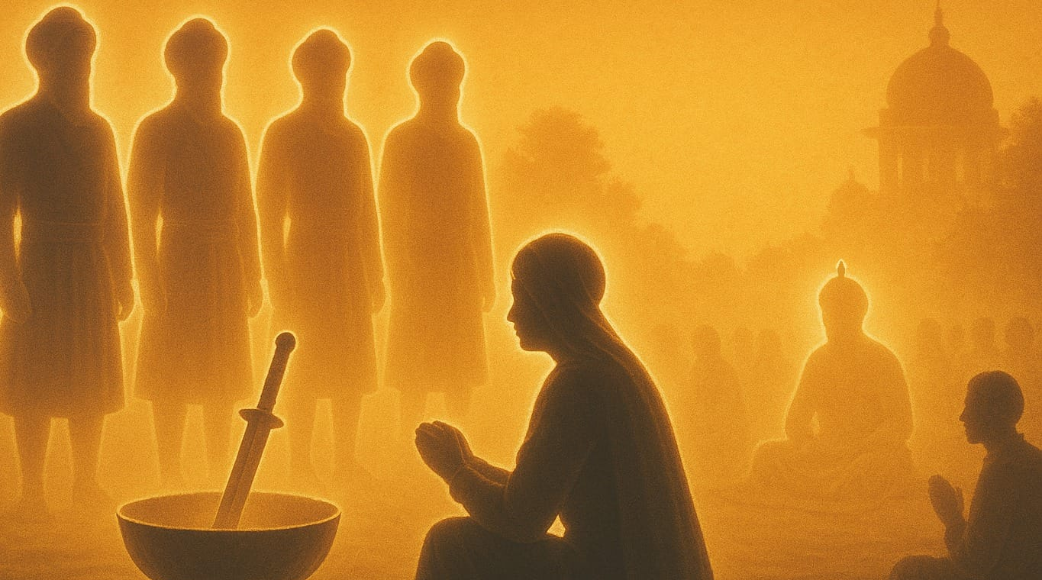
VAISAKHI:
RENEWING FAITH & COMMITMENT
On Vaisakhi 1699, the Tenth Guru tested the faith of his Sikhs. Five Sikhs stepped forward, killing their ego and showing true faith.
Five Sikhs were brought back to life and spiritually awakened through the Amrit baptism ceremony & given the title - KHALSA.
The Five then led the ceremony for others wishing to become KHALSA (the Pure) –
Saint-Soldiers committed to purity of mind, body & spirit.

Slide 6
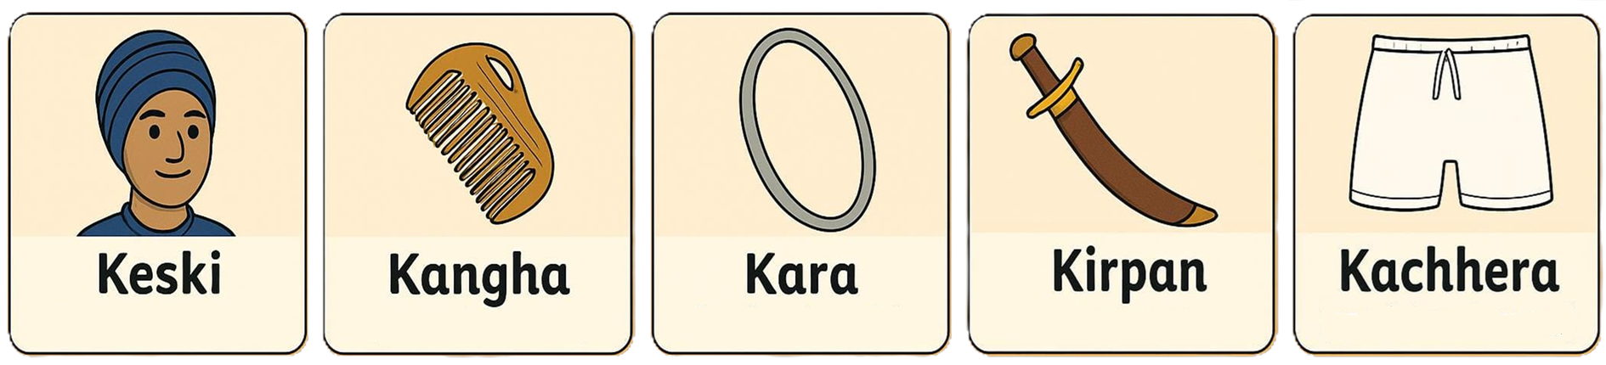
Those wishing to represent Sikhi and commit themselves to higher spiritual living (the Khalsa) & being the Holy Army of the Divine are given a spiritual uniform that embodies the spirit of Sikh teachings:
Holy Turban of HONOUR & HUMILITY, covering the sacred Kes (uncut hair)
Holy Wooden Comb of CLEANLINESS & MINDFULNESS, kept in the hair-knot
Holy Iron Bangle of INTEGRITY & DUTY, worn on the wrist
Holy Sword of PEACE & COMPASSION, worn in a secured strap (gatra)
Holy Shorts of MODESTY & SELF-RESTRAINT, which are specially tailored
Known as the 5 Ks

Slide 7
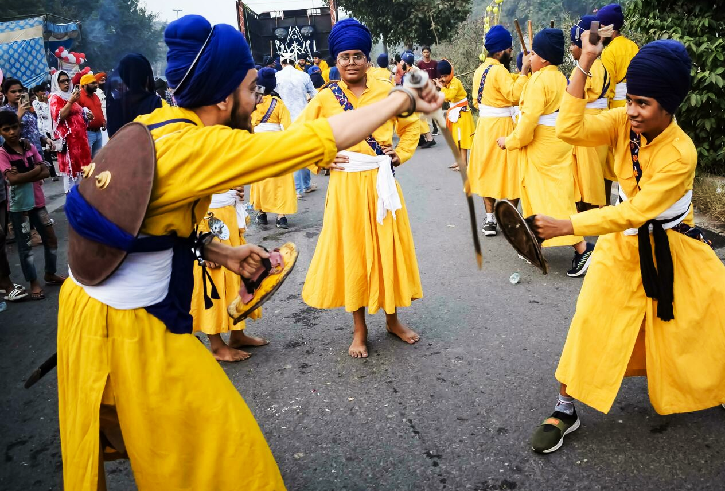
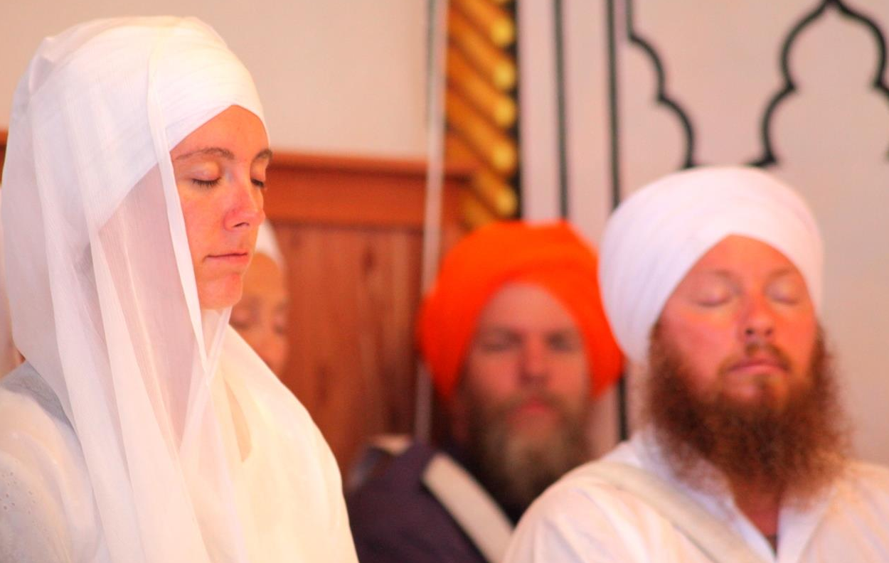
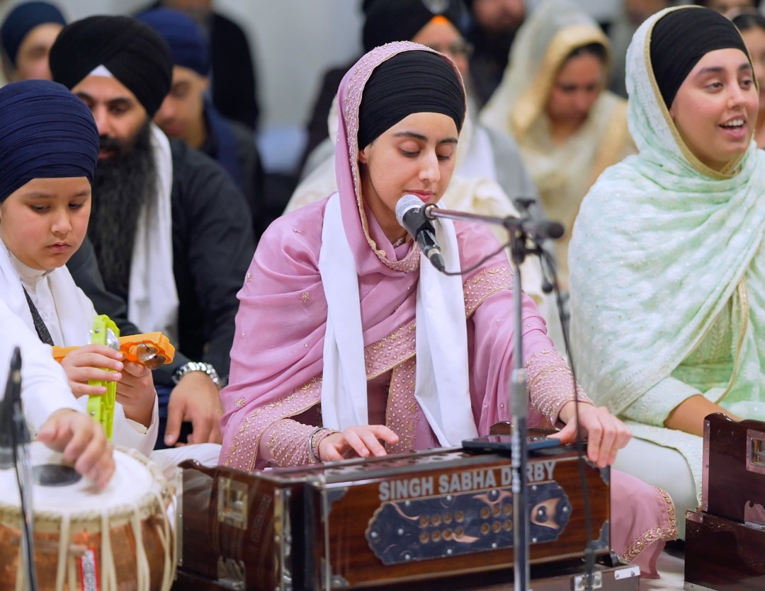
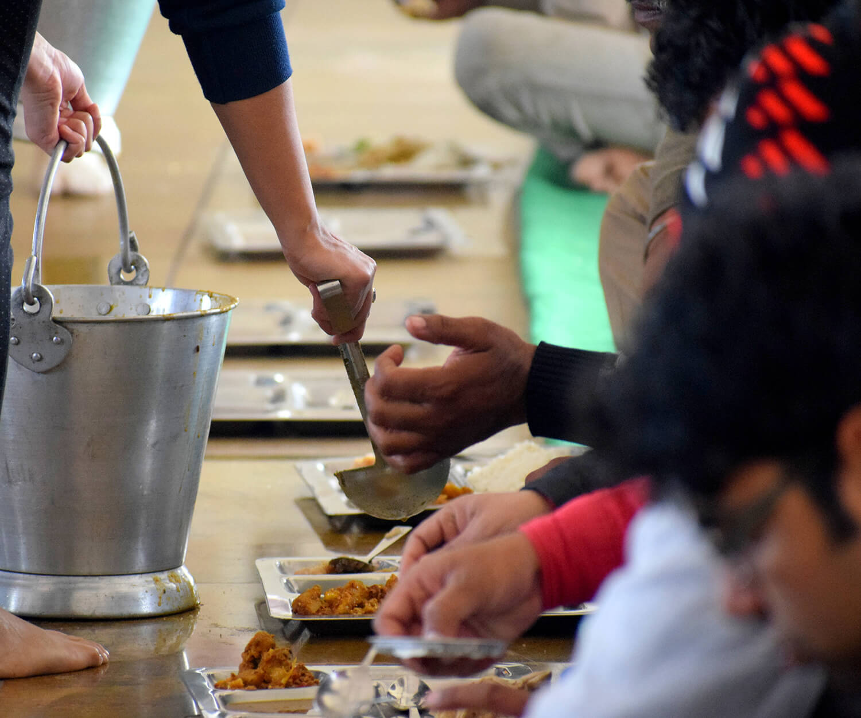
HOW DO SIKHS CELEBRATE VAISAKHI?
GURDWARA SERVICES: Sikhs visit the Gurdwara to participate in prayers, musical worship (Kirtan), the hearing the re-telling of history & partake in Langar (Guru’s Kitchen).
SEVA (SELFLESS-SERVICE): With an emphasis on equality, charity & helping others, Sikhs regularly engage in outreach activities beyond their own faith community.
STEPPING-UP:
An opportunity to reflect and be inspired to step up in becoming Khalsa (Pure) — committing mind, body, and spirit to Purity and Divinity through initiation in the Amrit ceremony.
COMMUNITY PROCESSIONS:
Sharing love and understanding with the wider public through musical worship (Kirtan), martial arts displays, and serving free food to all.

Slide 8

THE INSIGNIA OF SIKHI
The Khanda (double‑edged sword): Represents there is One Universal Supreme Being — the Divine Parent, Friend, & Guide to all — and the power of Truth that cuts through falsehood.
The Chakkar (circular quoit):
Represents that all humanity is one family, linked by the same Divine Light, and Sikhs are called to serve and protect all.
Two Kirpans (sacred swords):
The left sword represents Piri (sainthood)— overcoming the mind’s negativities & finding inner peace.
The right sword represents Miri (soldierhood) — standing up to injustice and helping build a fairer, more harmonious society.

Slide 9
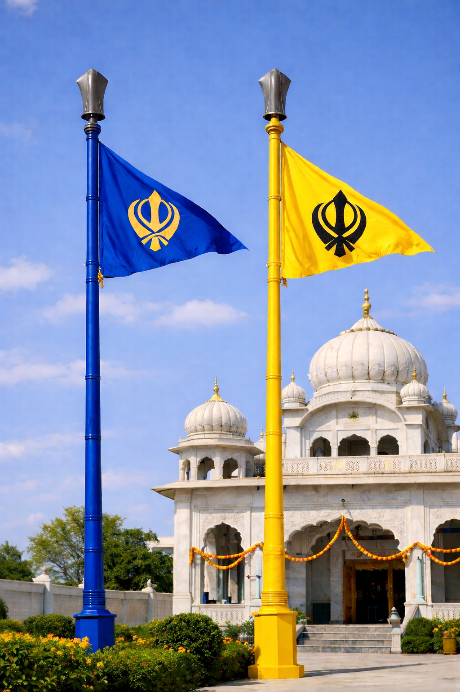
VAISAKHI:
NISHAN SAHIB CEREMONY
In front of every Sikh gurdwara, you’ll see a tall Sikh flag (the Nishan Sahib), either blue (symbolising equality like the open sky) or yellow (symbolising upliftment & joy). The Sikh flag marks a space free from hate & fear: a space of spiritual nourishment, refuge for those in need, food for the hungry, & protection for all.
Each Vaisakhi, the cloth of the sacred flag is respectfully renewed in a special ceremony with sacred hymns & shared food.

